Slide 1
DEPARTMENT OF ENERGY SYSTEMS ENGINEERING

Slide 2
Energy Systems Engineering
History
The base of the department extends to the year of 1992 which “Technical Education Faculty” was established.
In 2009 Technical Education Faculty was changed by the government to “Technology Faculty” Energy System Engineering Department was one of the first departments which was started its academic studies at Technology Faculty.

Slide 3
Energy Systems Engineering
Mission
Our mission is to train social and creative engineers who are fit for teamwork, responsible and sensitive to environment, can successfully take part in design, production, application and research-development studies of industrial and research institutions, possess a systematical approach in solving problems, have leader characteristics and conscience for economical and professional ethics by giving universally theoretical and practical bachelors and master education and on-the-job training in accordance with the ideals of Ataturk, modern and ethical values, crediting the superiority of law; to find solutions to the problems of the national industry by conducting research which produces information and technology in international level.
Notes:
İpucu: Konuşmacı notlarınızı buraya ekleyin.

Slide 4
Energy Systems Engineering
Vision
The vision of our faculty is to become a research institution possessing developed organizational connections with the national and international science and technology world and the industry, a strong institutional identity and culture, which gives education in equivalence with similar faculties of national and international qualified universities. So as to actualize our mission, we aim to become a respected and approved faculty serving its country, consistently updating its research, development, instruction and education infrastructure, having academic staff who prioritize research, modern science and technology along with life-long learning and instruction. The lesson plans and contents of our Faculty of Technology have been developed in according with the needs of the Turkish industry, taking into account the principles of competent engineering (MUDEK- Association for Evaluation and Accreditation of Engineering Programs) and Europe (Erasmus-Socrates) and USA (ABET) education programs.
Notes:
İpucu: Konuşmacı notlarınızı buraya ekleyin.

Slide 5
About Energy Systems Engineering
Energy Systems Engineering Department is within the Technology Faculty and education has been formed in two periods of a day (I. and II. education period). This department educational program is 4 year for undergraduate level students. Furthermore, students are registered from (MTOK) continue to 1 year scientific preperation program. Educational language of the department is Turkish.
Graduated students have a general range of knowledge and satisfy the requirements of energy workshop, and can work international projects with other colleaques. Design of HVAC systems, new generation renewable energy systems, Nuclear energy, Hydrogen energy and Efficiency analyses of a system are gained by the students along their eduation period.

Slide 6
About Energy Systems Engineering
Specialised Research Areas
Engineering Economics and Energy Efficiency
Wind Energy
Solar Energy
Cooling Systems
Heating, Ventilation and Air Conditioning
Mechanical Installation
Fuel Cells
Hybrid Systems

Slide 7
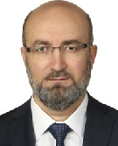
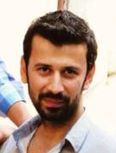
Administrative Staff
Prof.Dr.Mehmet ÖZKAYMAK
Head of Department
Asst.Prof.Dr.Şafak ATAŞ
Vice Head of Department
Vice Head of Department

Slide 8
Energy Systems Engineering
Course Credits (ECTS)
Elective courses: 55
Technical elective courses: 47
Social elective courses: 8
Fundamental courses: 35
Engineering courses: 115
Field courses: 35
Total credits: 240
Credits of theoretical courses: 150
Credits of practical courses: 90

Slide 9
Energy Systems Engineering
Double Major Programs
Mechanical Engineering
Manufacturing Engineering
Mechatronics Engineering
Industrial Design Engineering

Slide 10
Energy Systems Engineering
Graduation
The students who study in the programme must fulfil the following graduation requirements to get the Bachelor’s Degree:
The students must pass all the credited courses with at least a letter grade C, together with non-credited courses with at least the letter grade G.
They must obtain a total of 240 ECTS Credits at the end of the 4-year study.
They must have a Cumulative Grade Point Average (CGPA) of 2.5 out of 4.00 (60 out of 100).
They must prepare a graduation thesis, submit and defend it successfully.
For detailed information, please see Karabuk University Rules and Regulation for Undergraduate Education, Examination and Assessment:
http://oidb.karabuk.edu.tr/en/yonet/egitimogretim.pdf

Slide 11
Energy Systems Engineering
Graduate Programs
Master’s and Ph.D Degree
Energy Systems Engineering (Institute of Natural and Applied Science)

Slide 12
Energy Systems Engineering
Faculty Members
Number of Professor : 5
Number of Associate Professor: 3
Number of Assistant Professor: 6
Number of Lecturer: 1
Number of Teaching Assistant : 5
Number of Teaching Assistant (Doctor): 1

Slide 13
Academic Staff
Prof.Dr.MEHMET ÖZKAYMAK
E-mail: mozkaymak@karabuk.edu.tr
Phone:+90 370 418 71 00 / 1300
Address: Karabuk / Turkey
Research Interests
Energy Efficiency, Thermal Energy Systems,Exergy, Renewable Energy Sources
Recent Academic Studies
Özkaymak, M., Tabak, A., Canan, A., Aksay, M. V., İnanç, Ö., & Eruz, Ü. G. (2017). Efficiency And Investment Comparison of Monocrystalline, Polycrystalline, and Thin Film Solar Panel Types at Karabuk Conditions. I-Manager’s Journal on Power Systems Engineering, 5(3), 1–9.
Özkaymak, M., Ceylan, M. A., Okutan, H. C., Atakul, H., Engin, B., Çoşkun, T., & İnanç, Ö. (2017). CO₂ Emission During The Combustion Of Orhaneli Lignite Coal” World Journal Of Engineering, 14(1), 27–34.

Slide 14
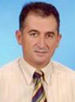
Academic Staff
Prof.Dr. SEZAYİ YILMAZ
E-mail: syilmaz@karabuk.edu.tr
Phone:+90 370 418 71 00 / 1013
Address: Karabuk / Turkey
Research Interests
Solar Energy, Alternative Energy Sources, Thermal Energy Systems
Recent Academic Studies
A.E. GÜREL, İ. CEYLAN, and S. YILMAZ, “Thermodynamıc analysıs of PID controlled fluıdızed bed dryer wıth parabolıc trough collector,” International Journal of Exergy, pp. 0–0, 2015.
A. E. GÜREL, İ. CEYLAN, and S. YILMAZ, “Pompalı ve Parabolik Oluklu Güneş Kollektörlü Akışkan Yataklı Kurutucuların Deneysel Analizi,” journal of Thermal Science and Technology , pp. 0–0, 2015.

Slide 15
Academic Staff
Prof.Dr. ZİYADDİN RECEBLİ
E-mail: zrecebli@karabuk.edu.tr
Phone:+90 370 418 71 00 / 1333
Address: Karabuk / Turkey
Research Interests
Thermodynamics,Heat Transfer,Fluid Mechanics,
Recent Academic Studies
S. SELİMLİ, Z. RECEBLİ, and E. ARCAKLIOĞLU, “Electrical field effect on three dimensional magnetohydrodynamic pipe flow a CFD study,” Progress in Computational Fluid Dynamics, An International Journal, vol. 16, no. 4, pp. 261–270, Jan. 2016.
S. SELİMLİ, Z. RECEBLİ, and S. Ülker, “Solar Vacuum Tube Iitegrated Seawater Desalinization an Experimental Study,” Scientific Journal Facta Universitatis, Series Mechanical Engineering, vol. 14, no. 1, pp. 113–120, Apr. 2016

Slide 16
Academic Staff
Prof.Dr. İLHAN CEYLAN
E-mail: ilhanceylan@karabuk.edu.tr
Phone:+90 370 418 71 00 / 1337
Address: Karabuk / Turkey
Research Interests
Solar energy, HVAC
Recent Academic Studies
CEYLAN, A. E. GÜREL, and A. ERGÜN, “The mathematical modeling of concentrated photovoltaic module temperature,” International Journal of Hydrogen Energy, vol. 31, pp. 19641–19653, Aug. 2017.
M. AKTAŞ, İ. CEYLAN, A. ERGÜN, A. E. GÜREL, and M. ATAR, “Assessment of a solar-assisted infrared timber drying system,” Environmental Progress Sustainable Energy, vol. 36, no. 6, pp. 1875–1881, 2017.

Slide 17
Academic Staff
Prof.Dr. Hacı Mehmet ŞAHİN
E-mail: mehmetsahin@karabuk.edu.tr
Phone:+90 3704187100 / 1413
Address: Karabuk / Turkey
Research Interests
Thermal Power Systems, Renewable Energy Systems, Concentrated Solar Powers, Computational Fluid Dynamics, Neutron Transport Theory and Simulation, Nuclear Radiation Shielding, Fusion-Fission (Hybrid) Reactors
Recent Academic Studies
Sümer Şahin, Hacı Mehmet Şahin, Comprehensive Energy Systems, 1.20 Nuclear Energy, Vol. 1, Pages 795-849, (Editor: İbrahim Dinçer), Elsevier, 2018.
S Şahi̇n, HM Şahin, G Tunç, Monte Carlo analysis of LWR spent fuel transmutation in a fusion-fission hybrid reactor system, Nuclear Engineering and Technology, Vol. 50 (8), pp 1339-1348, 2018.

Slide 18
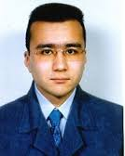
Academic Staff
Prof. Dr. MUSTAFA BARIŞ TERCAN
E-mail: mtercan@karabuk.edu.tr
Phone:+90 370 418 71 00 / 1289
Address: Karabuk / Turkey
Research Interests
Solar Cells, Electronics, crystallography
Recent Academic Studies

Slide 19
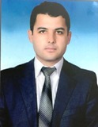
Academic Staff
Assoc.Prof.Dr. MUHAMMET KAYFECİ
E-mail: mkayfeci@karabuk.edu.tr
Phone:+90 370 418 71 00 / 1127
Address: Karabuk / Turkey
Research Interests
Fuel Cells, Heat Transfer, Insulation Technologies.
Recent Academic Studies
Ü. Elmas, F. BEDİR, and M. KAYFECİ, “Computational analysis of hydrogen storage capacity using process parameters for three different metal hydride materials,”International Journal of hydrogen energy, pp. 1–14, Dec. 2017.

Slide 20
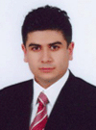
Academic Staff
Assoc.Prof.Dr. ENGİN GEDİK
E-mail: egedik@karabuk.edu.tr
Phone:+90 370 418 71 00 / 1109
Address: Karabuk / Turkey
Research Interests
Nanofluids, Computational Fluid Dynamics, Heat Pipe
Recent Academic Studies
E. GEDİK, “Experimental and Numerical Investigation on Laminar Pipe Flow of Magneto-Rheological Fluids under Applied External Magnetic Field,” Journal of Applied Fluid Mechanics, vol. 10, no. 3, pp. 801–811, 2017.

Slide 21
Academic Staff
Assist.Prof.Dr. BAHADIR ACAR
E-mail: bacar@karabuk.edu.tr
Phone:+90 370 418 71 00 / 1111
Address: Karabuk / Turkey
Research Interests
Solar Energy, Freeze drying.
Recent Academic Studies
A. ERGÜN, İ. CEYLAN, B. ACAR, and H. ERKAYMAZ, “Energy–exergy–ANN analyses of solar-assisted fluidized bed dryer,” Drying Technology, vol. 35, no. 14, pp. 1711–1720, Dec. 2017.

Slide 22
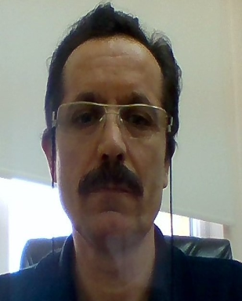
Academic Staff
Assist.Prof.Dr. METİN KAYA
E-mail: mkaya@karabuk.edu.tr
Phone:+90 370 418 71 00
Address: Karabuk / Turkey
Research Interests
Alternative Heating and Cooling Systems, Natural gas systems, Sanitary Systems.
Recent Academic Studies

Slide 23
Academic Staff
Assist.Prof.Dr. ŞAFAK ATAŞ
E-mail: satas@karabuk.edu.tr
Phone:+90 370 418 71 00/1045
Address: Karabuk / Turkey
Research Interests
HVAC, Cooling Systems, Heat pump
Recent Academic Studies
Ş. ATAŞ, M. AKTAŞ, İ. CEYLAN, and H. DOĞAN, “Development and Analysis of a Multi-evaporator Cooling System with Electronic Expansion Valves,” Arabian Journal for Science and Engineering, pp. 1–9, Apr. 2017.

Slide 24
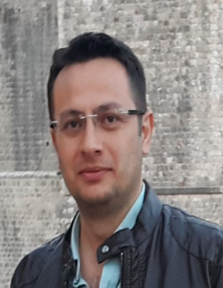
Academic Staff
Assist.Prof.Dr. ALPER ERGÜN
E-mail: alperergun@karabuk.edu.tr
Phone:+90 370 418 71 00/1098
Address: Karabuk / Turkey
Research Interests
Energy efficiency and Exergy, Thermodynamics,Organic Rankine Cycle, Photovoltaic Thermal Systems
Recent Academic Studies
Ergün A., Eyinç H., "Performance assessment of novel photovoltaic thermal system using nanoparticle in phase change material", International Journal Of Numerical Methods For Heat & Fluid Flow, vol.29, pp.1490-1505, 2019
Ceylan İ., Yilmaz S., İnanç Ö., Ergün A., Gürel A.E., Acar B., et al., "Determination of the heat transfer coefficient of PV panels", ENERGY, vol.175, pp.978-985, 2019
Zuhur S., Ceylan İ., Ergün A., "Energy, exergy and environmental impact analysis of concentrated PV/cooling system in Turkey", Solar Energy, vol.180, pp.567-574, 2019.

Slide 25
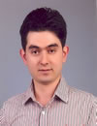
Academic Staff
Assist.Prof.Dr. SELÇUK SELİMLİ
E-mail: selcukselimli@karabuk.edu.tr
Phone:+90 370 418 71 00/1338
Address: Karabuk / Turkey
Research Interests
Thermodynamics,Heat Transfer,Fluid Mechanics,
Recent Academic Studies
S. SELİMLİ, Z. RECEBLİ, and S. Ülker, “SOLAR VACUUM TUBE INTEGRATED SEAWATER DISTILLATION AN EXPERIMENTAL STUDY,” Facta Universitatis, series: Mechanical Engineering (FU Mech Eng), vol. 14, no. 1, pp. 113–120, Apr. 2016.

Slide 26
Academic Staff

Slide 27
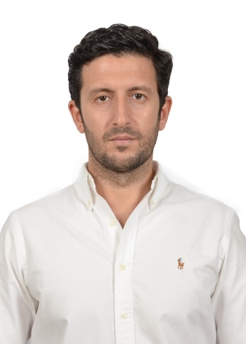
Academic Staff
Dr. Turgut Sönmez
E-mail: turgutsonmez@karabuk.edu.tr Phone: +90 370 418 71 00/1291 Address : Karabuk-Turkey
Research Interests: Electrochemistry, Metal-Air Batteries, Fuel cells, Water Oxidation, Catalysis, Nano-Materials
Recent Academic Studies
T. Sonmez, S.J. Thompson, S.W.T. Price, D. Pletcher, A.E. Russell, |Voltammetric Studies of Oxygen Reduction in Alkaline Media at the Spinels Co3O4 and NiCo2O4, J.Electrochem.Soc., 163, 10, (2016) .
D. Pletcher, X.H. Li, S.W.T. Price, A.E. Russell, T. Sonmez, S.J. Thompson, |Comparison of the Spinels Co3O4 and NiCo2O4 as Bifunctional Oxygen Catalysts in Alkaline Media, Electrochim. Acta, 188, 286 (2016).

Slide 28
Academic Staff
Research Assistants
Res. Assist. Dr. Mehmet Volkan AKSAY
Res. Assist. Özgür İNANÇ
Res. Assist. Ahmet CANAN
Res. Assist. Yakup DAŞDEMİRLİ
Res. Assist. Hakan DUMRUL
Res. Assist. Edip TAŞKESEN

Slide 29
Energy Systems Engineering
Laboratories
Fluid Mechanics lab.
Heat lab.
HVAC Lab.
Mechanic lab.

Slide 30
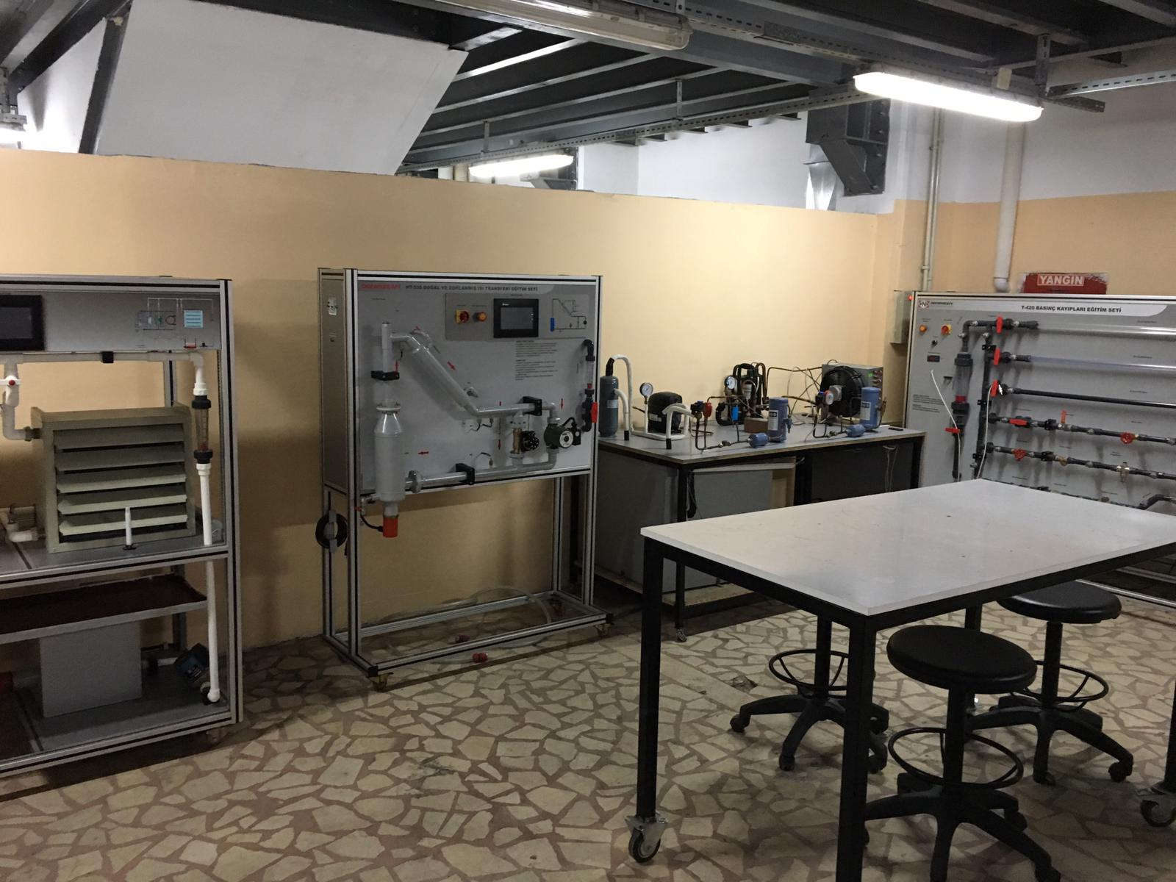
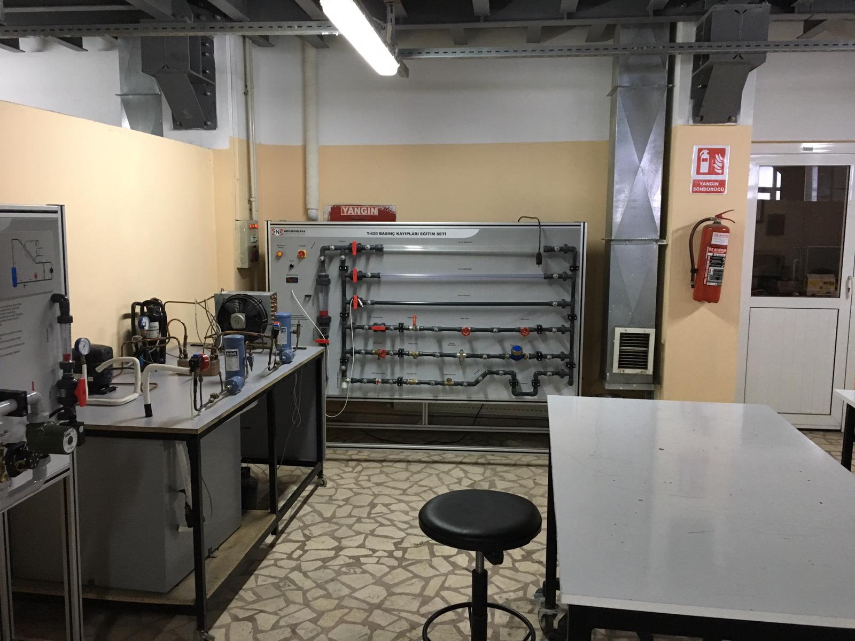
Energy Systems Engineering
Fluid Mechanics lab.

Slide 31
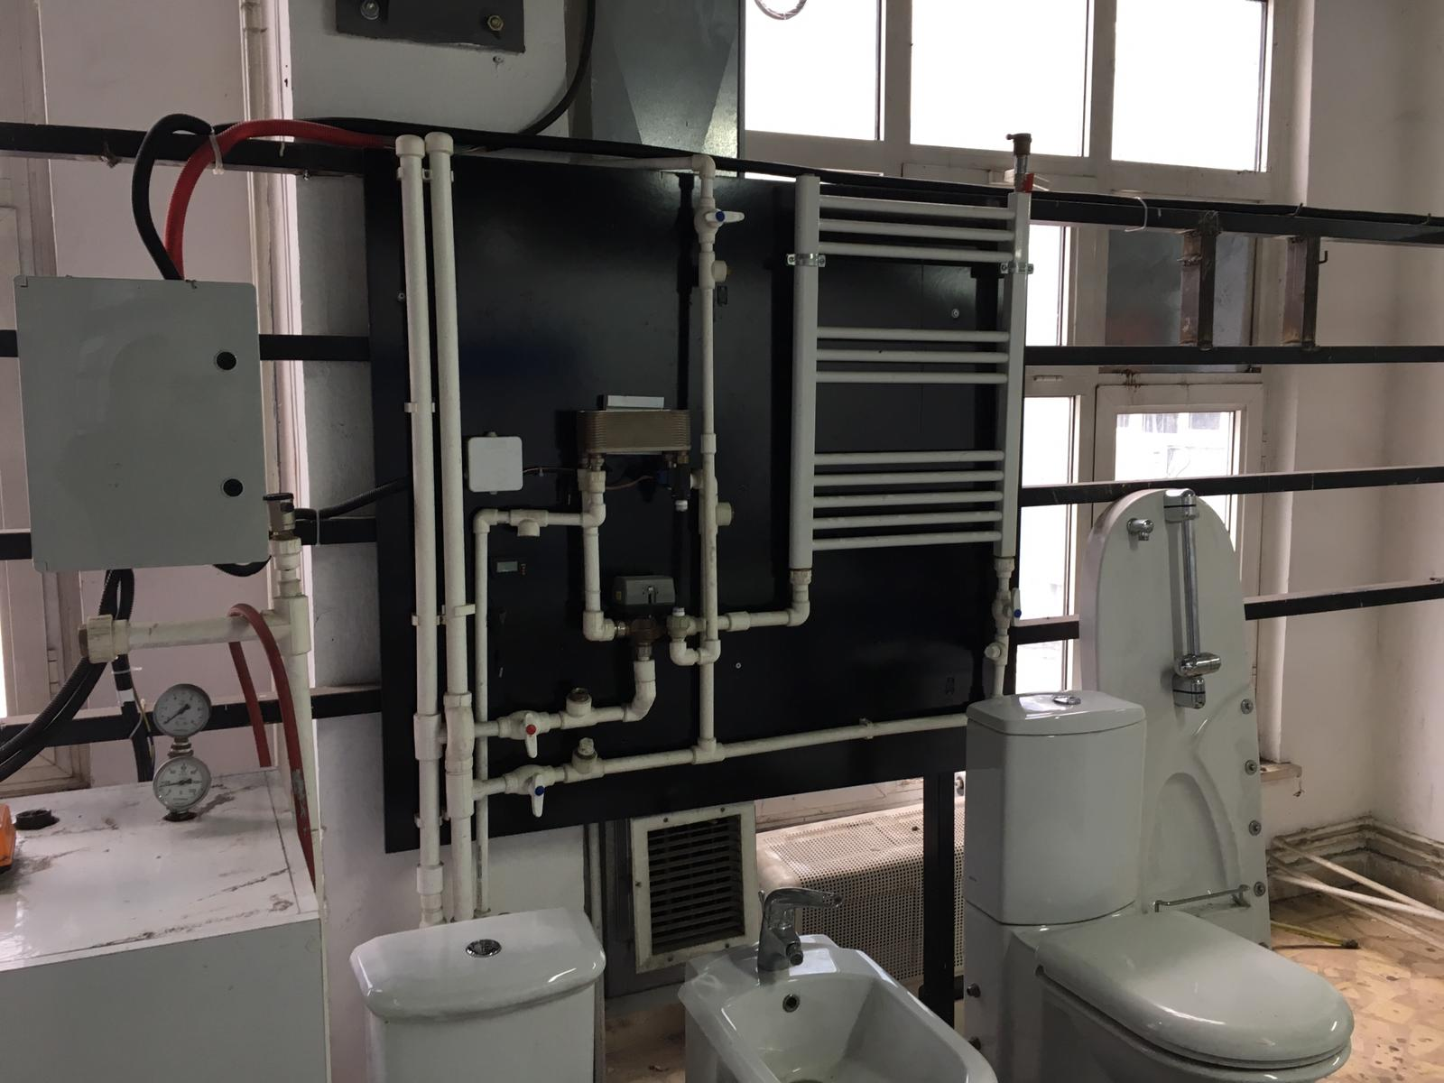
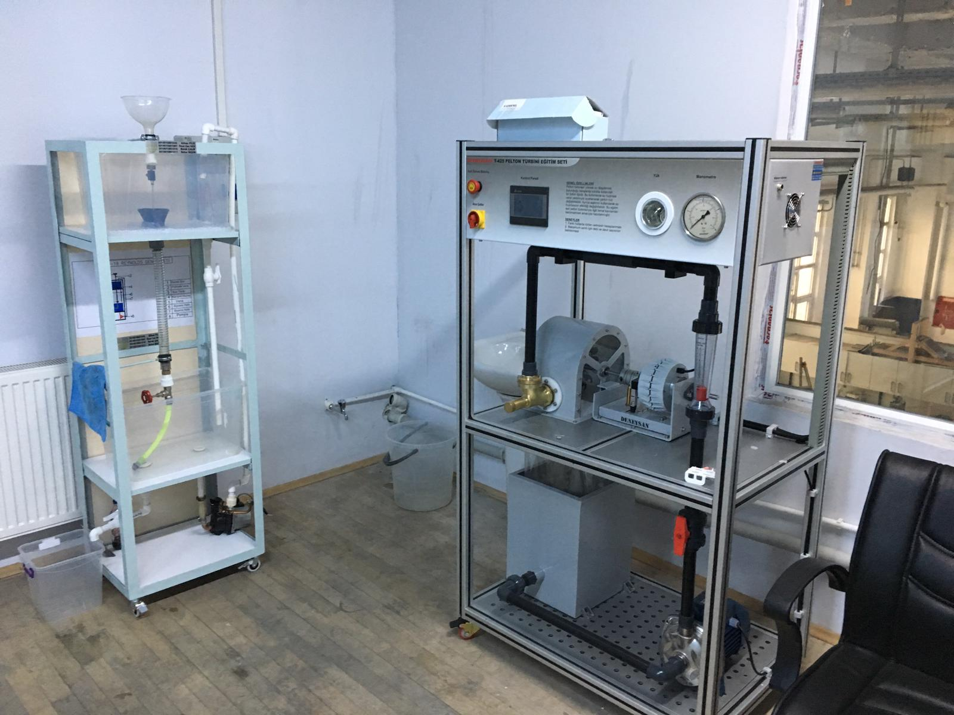
Energy Systems Engineering
Heat Lab.

Slide 32
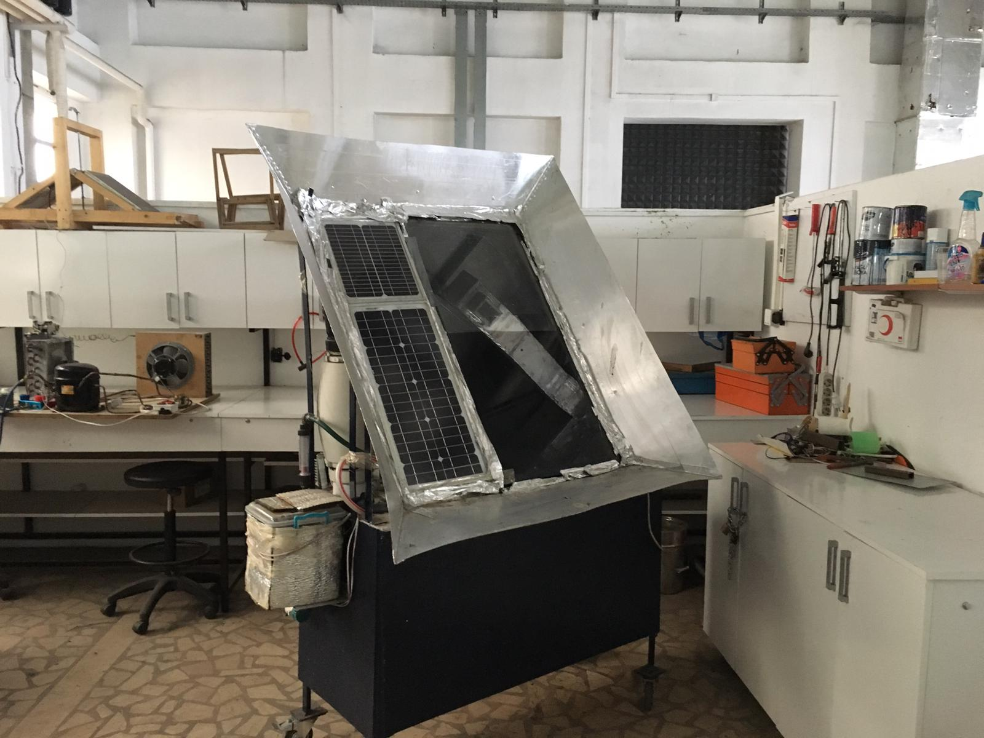
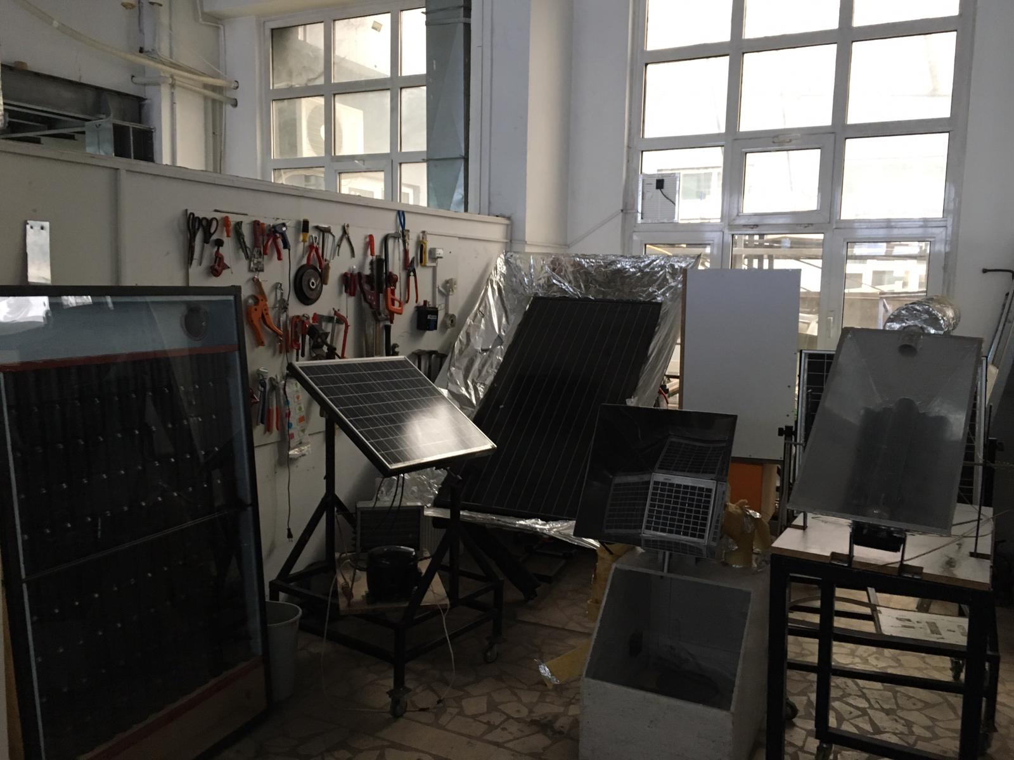
Energy Systems Engineering
HVAC Lab.

Slide 33
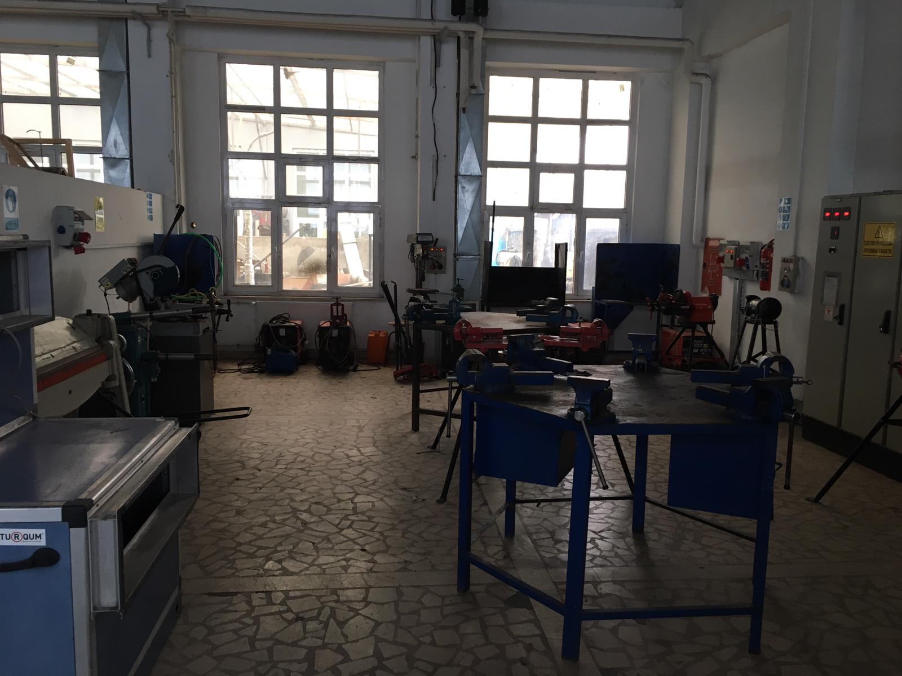
Energy Systems Engineering
Mechanic Lab.

Slide 34
Projects
Determination of Optimum Operating Conditions for Biogas Production by Anaerobic Coffermantation Method of Different Tumble Wastes. KBÜ-BAP-16/2-DR-082
Condensed Photovoltaıc Panel Desıgn, Manufacturıng And Experımental Analysıs. KBÜBAP-17-DR-199
Design and Analysis of Solar Energetic Air Collecting and with PV / T Collector Supported Solar Energized Air Collector Drying Systems. KBÜBAP-17-YL-245
Experimental and theoretical investigation of nano fluid hybrid PV / T system. KBÜBAP-17-DR-262
Experimental investigation of hydrogen storage in multi-walled carbon nanotubes with various nanoparticles. KBÜ-BAP-16/1-DR-081
Numerical Investigation of Laminer Flow and Forced Heat Transport of Nanoparticles in Sudden Expansion Channels with Calculated Fluid Dynamics. KBÜ-BAP-16/1-YL-101

Slide 35
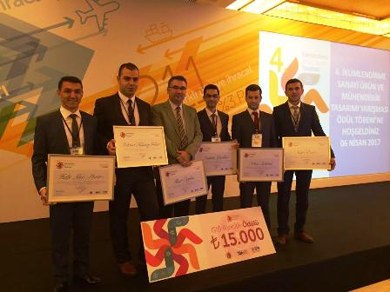
Awards
Name of the competition: İklimlendirme Sanayi Ürün ve Mühendislik Tasarım 2017 (Air Conditioning Industry Product and Engineering Design)
Name of the project: Solar Collector with condensing heat storage
Award : 2nd - 15.000 TL
Prof.Dr. İlhan CEYLAN
M. Tolunay GÖKER,
Atakan YENİLİKÇİ,
Naim ÖZETÇİ,
Halit Akın ÖRS,
Selim ADAKUL.

Slide 36
Employment Fields
Energy systems engineers pursue a variety of jobs and occupations.
Design of HVAC systems
Solar and Wind energy plants,
Hydrogen energy,
Nuclear energy,
Energy Efficiency and Management,
Thermal plants,
New generation renewable energy systems.

Slide 37
Energy Systems Engineering
Contact Information
Postal address: Balıklarkayası Mevkii, Demir Çelik Kampüsü, Teknoloji Fakültesi 78050 Karabük/Türkiye
Department web page:
http://teknoloji.karabuk.edu.tr/enerjisistemleri-en
E-mail: teknolojifakultesi@karabuk.edu.tr

