Slide 1
DEPARTMENT OF INDUSTRIAL DESIGN ENGINEERING

Slide 2
Industrial Design Engineering
Industrial design engineering program has accepted students for under graduate degree since 2012-2013 fall semester.
It fills a great gap in meeting the requirement of Creative, Innovative Industrial Design Engineers who follow quality and up-to-date design/application technologies of national industry.

Slide 3
Industrial Design Engineering
Mission
To educate engineers who can apply the theoretical design skills to the engineering problems, use software in design applications, produce industrial solutions, be the team leader, have high self-confidence, take responsibility.
Notes:
İpucu: Konuşmacı notlarınızı buraya ekleyin.

Slide 4
Industrial Design Engineering
Vision
A department that provides a industrial design engineering education that meets the highest global standards;
A department that is innovative, pioneering and leading in education, research and service;
A department that has faculty, staff and students who seek perfection through collaborative, high quality and meaningful productivity.

Slide 5
About Industrial Design Engineering
Industrial Design Engineering is a discipline of engineering dealing with various design and analysis applications, the research and development of products and systems.

Slide 6
About Industrial Design Engineering
Business Sectors
Automotive Industry
Manufacturing Industry
Biomedical Industry
Construction Field
Furniture Industry
Industrial Product Design

Slide 7
About Industrial Design Engineering
Specialised Research Areas
Industrial Product Design
Metal Forming and Applications
Plastic Molds Design and Applications
Rapid Prototyping and 3D Printers
Polymer Composites
Furniture Design
CAD/CAM/CAE Applications
CNC System Design

Slide 8
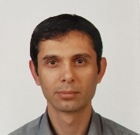
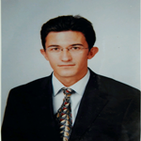
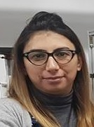
Administrative Staff
Doç.Dr. Kerim ÇETİNKAYA
Head of Department
Assist.Prof.Dr. Hatice EVLEN
Vice Head of Department
Assist.Prof.Dr. Musa YILDIRIM
Vice Head of Department

Slide 9
Industrial Design Engineering
Course Credits
Elective courses: 43 Credits (58 ECTS)
Technical elective courses: 27 Credits (42 ECTS)
Social elective courses: 16 Credits (16 ECTS)
Fundamental courses: 35,5 Credits (36 ECTS)
Engineering courses: 71 Credits (88 ECTS)
Field courses: 95,5 Credits (133 ECTS)
Total credits: 202 Credits (300 ECTS)
Credits of theoretical courses: 146 Credits (172 ECTS)
Credits of practical courses: 56 Credits (128 ECTS)

Slide 10
Industrial Design Engineering
Minor Programs
Technology Faculty Energy Systems Engineering
Technology Faculty Mechatronics Engineering
Technology Faculty Manufacturing Engineering
Major Programs
Technology Faculty Energy Systems Engineering
Technology Faculty Mechatronics Engineering
Technology Faculty Manufacturing Engineering
Engineering Faculty Mechanical Engineering
Enginnering Faculty Industrial Engineering

Slide 11
Industrial Design Engineering
Graduate Programs
Master’s Degree
Have valid Bachelor’s Degree
Students take 21 Credits (60 ECTS) courses
Defend a thesis

Slide 12
Industrial Design Engineering
Graduate Programs
Doctorate (Ph.D.) Degree
Have valid Bachelor’s Degree or M.Sc. Degree
Have valid English Score (TOEFL/YDS-min.55 score)
Students take 60 Credits (60 ECTS) courses
Pass the Proficiency Exam
Defend a thesis

Slide 13
Industrial Design Engineering
Department Members
Number of Professor : 2
Number of Associate Professor: 1
Number of Assistant Professor: 3
Number of Research Assistant : 3

Slide 14
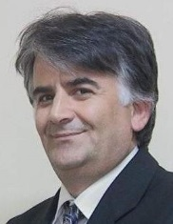
Academic Staff
Prof.Dr. İbrahim KADI
E-mail: ibrahimkadi@karabuk.edu.tr
Phone: +90(370)418 9066
Address: Karabuk University Technology Faculty Industrial Design Engineering Department Balıklarkayası Mevkii
78050 Merkez/Karabuk/TURKEY
Research Interests
Machine Design. Computer Aided Design. Metal Forming.
Recent Academic Studies
Mustafa YAŞAR, İbrahim KADI, ‘High velocity forming of aluminum cylindrical cups-experiments and numerical simulations’, Journal of Materials Science & Technology, Vol.23, No.2, 2007.
Mustafa YAŞAR, İbrahim KADI, ‘Bir saf detonasyon motorunun su içerisindeki tepkisinin deneysel olarak incelenmesi’, Journal of Faculty Engineering Arch. Gazi Üniv., Vol.21, No.3, 2006.
Elmas AŞKAR, İbrahim KADI, Mustafa YAŞAR, ‘Small diameter hydrostatic forming of AL5754 and AL1050 sheets’, Technology, Vol.13, No.1, 2010.

Slide 15
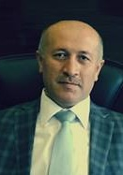
Academic Staff
Prof.Dr. Mustafa YAŞAR
E-mail: myasar@karabuk.edu.tr
Phone: +90(370)418 9009
Address: Karabuk University Technology Faculty Industrial Design Engineering Department Balıklarkayası Mevkii
78050 Merkez/Karabuk/TURKEY
Research Interests
Computer Aided Design. Metal Forming. Finite Element Analysis. Powder Metallurgy.
Recent Academic Studies
Şükrü şen, M. YAŞAR, and O. KOÇAR, “Dorse Tasarımında Stres Dağılım Analizi ve Topoloji Optimizasyonu,” Karaelmas Science and Engineering Journal, vol. 8, no. 1, pp. 309–316, Jun. 2018.
uğur bozali, M. YAŞAR, M. ÇETİN, V. V. ÇAY, and A. GÜNEN, “Investigation on wear mechanisms of boronized AISI 4150 steel,” Journal of Balkan Tribological Association, vol. 23, no. 1, pp. 1–15, Jan. 2017.
Ş. BÜLBÜL, N. AKÇAKALE, H. GÖKMEŞE, O. GÖK, and M. YAŞAR, “The effect on hardness and density of filling materials in NR SBR rubber compounds,” INTERNATIONAL ADVANCED RESEARCHES and ENGINEERING JOURNAL, vol. 1, no. 1, pp. 1–4, Dec. 2017.

Slide 16
Academic Staff
Assoc.Prof.Dr. Suat ALTUN
E-mail: saltun@karabuk.edu.tr
Phone: +90(370)418 9073
Address: Karabuk University Technology Faculty Industrial Design Engineering Department Balıklarkayası Mevkii
78050 Merkez/Karabuk/TURKEY
Research Interests
Furniture Design. Wood and Wood-Based Materials and Composites.
Recent Academic Studies
A. ÖZÇİFÇİ, E. S. KÖKTEN, N. AYRILMIŞ, G. ÖZBAY, and S. ALTUN, “Effects of catalysts on modulus of rupture and chemical structure of heat treated wood,” Drvna Industrija, vol. 69, no. 3, pp. 207–213, Oct. 2018.
Suat ALTUN, Veysel TOKDEMİR, ‘Modification with melamine formaldehyde and melamine-urea formaldehyde resin to improve the physical and mechanical properties of wood’, BioResources, Vol.12, No.1, 2017.
Suat ALTUN, Oğuzhan YÜKSEL, ‘Use of after sales service data in production management: A case study in a furniture firm’, 2nd International Furniture Congress, 2016.

Slide 17
Academic Staff
Assist.Prof.Dr. Hatice AKGÜL EVLEN
E-mail: hakgul@karabuk.edu.tr
Phone: +90(370)418 9092
Address: Karabuk University Technology Faculty Industrial Design Engineering Department Balıklarkayası Mevkii
78050 Merkez/Karabuk/TURKEY
Research Interests
Computer Aided Design. Metal Forming. 3D Printers. Bio-Materials. Composites.
Recent Academic Studies
H. EVLEN, A. Çalışkan, and N. DEMİRKOL, “Production and characterization of ceramic materials in three dimensional printer,” Arabian Journal of Geosciences, vol. 11, no. 16, pp. 1–6, Aug. 2018.
H. EVLEN, gülçin erel, and elif yılmaz, “3 Boyutlu Yazıcı Tasarımı Ve Yazdırma Doluluk Oranının Mekanik Özellikler Üzerine Etkisinin İncelenmesi,” International Journal of 3D Printing and Digital Industry, vol. 2, no. 1, pp. 23–31, Jan. 2018.
H. EVLEN, gülçin erel, and elif yılmaz, “Açık Ve Kapalı Sistem Tasarımının 3B Yazıcılarda Parça Mukavemetine Etkisinin İncelenmesi,” Politeknik Dergisi, pp. 0–0, 2018.

Slide 18
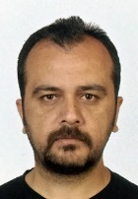
Academic Staff
Assist.Prof.Dr. Özkan ÖZ
E-mail: ooz@karabuk.edu.tr
Phone: +90(370)418 9094
Address: Karabuk University Technology Faculty Industrial Design Engineering Department Balıklarkayası Mevkii
78050 Merkez/Karabuk/TURKEY
Research Interests
Mechanics. Strength of Materials. Adhesives. Finite Element Method. Polymer Composites.
Recent Academic Studies
M. AYDIN and Ö. ÖZ, “APPLICATION OF DIGITAL IMAGE CORRELATION TECHNIQUE TO TENSILE TEST FOR PRINTED PLA SPECIMENS,” International Journal of 3D Printing Technologies and Digital Industry, vol. 2, no. 2, pp. 1–7, Jul. 2018.
Ö. ÖZ, M. AYDIN, A. S. KARA, and M. S. SANCAK, “ÜÇ BOYUTLU YAZICILARDA KULLANILAN DOLULUK ORANININ HASAR YÜKÜNE OLAN ETKİSİNİN BELİRLENMESİ,” International Journal of 3D Printing Technologies and Digital Industry, vol. 2, no. 1, pp. 32–39, Mar. 2018.

Slide 19
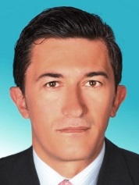
Academic Staff
Assist.Prof.Dr. Musa YILDIRIM
E-mail: musayildirim@karabuk.edu.tr
Phone: +90(370)418 9364
Address: Karabuk University Technology Faculty Industrial Design Engineering Department Balıklarkayası Mevkii
78050 Merkez/Karabuk/TURKEY
Research Interests
Powder Metallurgy. Metal-Based Composite Materials. Casting Technology.
Recent Academic Studies
M. YILDIRIM and D. ÖZYÜREK, “An Investigation of Wear Behaviors of AA7075 Al Hybrid Composites,” High Temperature Materials and Processes, vol. 37, no. 7, pp. 619–624, Jul. 2018.
İ. ŞİMŞEK, M. YILDIRIM, D. ÖZYÜREK, T. TUNÇAY, and D. ŞİMŞEK, “MEKANİK ALAŞIMLAMA ÖĞÜTME YÖNTEMİ İLE ÜRETİLEN Al SiC KOMPOZİTLERİNİNCELENMESİ,” Technological Applied Sciences, pp. 0–0, Apr. 2018.
İ. ŞİMŞEK, M. YILDIRIM, D. ÖZYÜREK, and T. TUNÇAY, “AA7075 ALAŞIMININ T6 ISIL İŞLEMİNDE YAŞLANDIRMA SÜRESİNİN AŞINMA DAVRANIŞI ÜZERİNE ETKİSİ,” İleri Teknoloji Bilimleri Dergisi, vol. 7, no. 1, pp. 42–49, 2018.

Slide 20
Academic Staff
Res.Assist. Murat AYDIN
E-mail: murataydin@karabuk.edu.tr
Phone: +90(370)418 9094
Address: Karabuk University Technology Faculty Industrial Design Engineering Department Balıklarkayası Mevkii
78050 Merkez/Karabuk/TURKEY
Research Interests
Metal Forming. Finite Element Analysis. Digital Image Correlation. 3D Printers.
Recent Academic Studies
M. AYDIN and Ö. ÖZ, “APPLICATION OF DIGITAL IMAGE CORRELATION TECHNIQUE TO TENSILE TEST FOR PRINTED PLA SPECIMENS,” International Journal of 3D Printing Technologies and Digital Industry, vol. 2, no. 2, pp. 1–7, Jul. 2018.
Ö. ÖZ, M. AYDIN, A. S. KARA, and M. S. SANCAK, “ÜÇ BOYUTLU YAZICILARDA KULLANILAN DOLULUK ORANININ HASAR YÜKÜNE OLAN ETKİSİNİN BELİRLENMESİ,” International Journal of 3D Printing Technologies and Digital Industry, vol. 2, no. 1, pp. 32–39, Mar. 2018.
M. AYDIN, X. WU, K. ÇETİNKAYA, İ. KADI, and M. YAŞAR, “Application of Digital Image Correlation in Uniaxial Tensile Test,” European Journal of Engineering and Natural Sciences, vol. 1, no. 1, pp. 23–32, Jan. 2016.

Slide 21
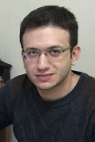
Academic Staff
Res.Assist. Abdurrahim TEMİZ
E-mail: abdurrahimtemiz@karabuk.edu.tr
Phone: +90(370)418 9020
Address: Karabuk University Technology Faculty Industrial Design Engineering Department Balıklarkayası Mevkii
78050 Merkez/Karabuk/TURKEY
Research Interests
Metal Foam. Heat Transfer. Finite Element Analysis. 3D Printers.
Recent Academic Studies
Abdurrahim TEMİZ, Koray ÖZDEMİR, M. Sait Cay, Levent TURHAN, Mustafa YAŞAR “ALTIGEN BAL PETEĞİ METAL KÖPÜK KANATLARA SAHİP KOMPAKT ISI DEĞİŞTİRİCİ TEORİK ANALİZİ”, 14th International Combustion Symposium (INCOS2018), 163-168.
A. Temiz and K. ÇETİNKAYA, “DEVELOPMENT OF STRATEGIC CHANGES WITH DIGITAL INDUSTRY,” presented at the VIII International Scientific and Practical Conference “Strategic Priorities of the Socio-Economic Development in Terms of Institutional Transformations of the Global Environment” , 2018.

Slide 22
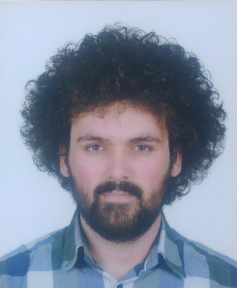
Academic Staff
Res.Assist. Fatih Huzeyfe ÖZTÜRK
E-mail: fhozturk@karabuk.edu.tr
Phone: +90(370)418 9020
Address: Karabuk University Technology Faculty Industrial Design Engineering Department Balıklarkayası Mevkii
78050 Merkez/Karabuk/TURKEY
Research Interests
Structural Adhesives.Finite Element Analysis. Mechanics
Recent Academic Studies
F. H. ÖZTÜRK, Ö. ÖZ, and K. ÇETİNKAYA, “THREE DIMENSIONAL POWDER AND GRANULA MIXER PROTOTYPE AND MANUFACTURİNG,” presented at the 3rd International Congress on 3D Printing (Additive Manufacturing)Technologies and Digital Industry 2018, Antalya, 2018.
Ç. CEBECİ, M. AYDIN, F. H. ÖZTÜRK, U. CAH, and H. EVLEN, “3B KOMPRESÖRLÜ SERAMİK YAZICI TASARIMI VE PROTOTİP ÜRETİMİ,” presented at the 2nd INTERNATIONAL SYMPOSIUM ON 3D PRINTING TECHNOLOGIES , 2017.

Slide 23
Industrial Design Engineering
Laboratories
Basic Operations Lab.
Polymer Development Lab.
Product Development Lab.
3D Printer Lab.
Measuring Lab.
CAD/CAM Lab.

Slide 24
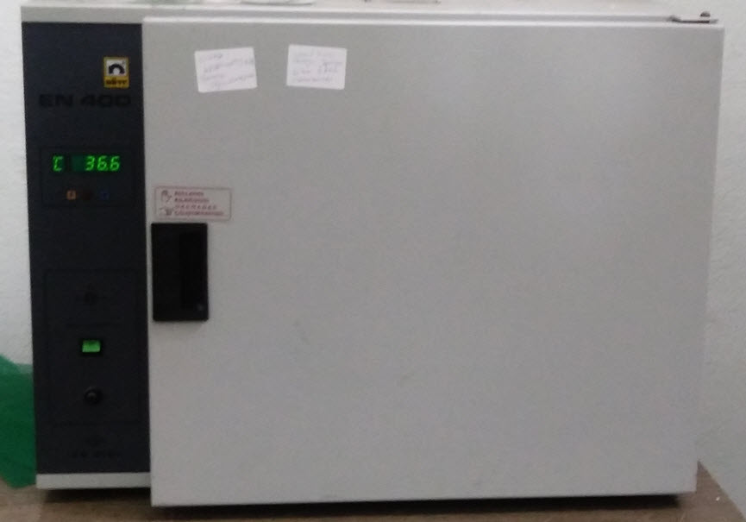
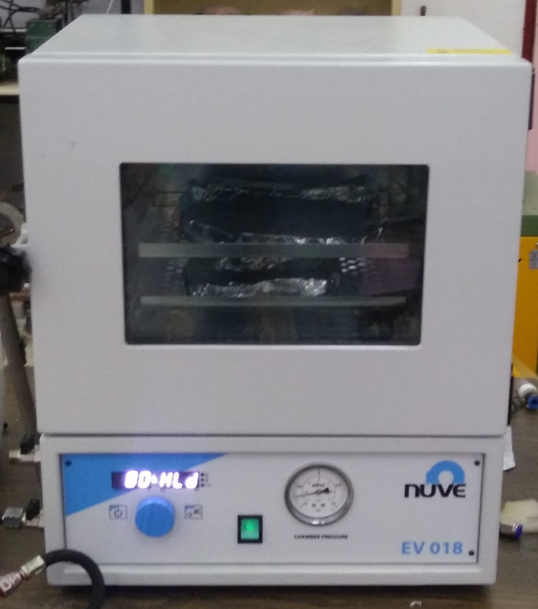
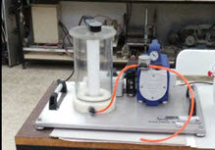
Industrial Design Engineering
Basic Operations Lab.

Slide 25
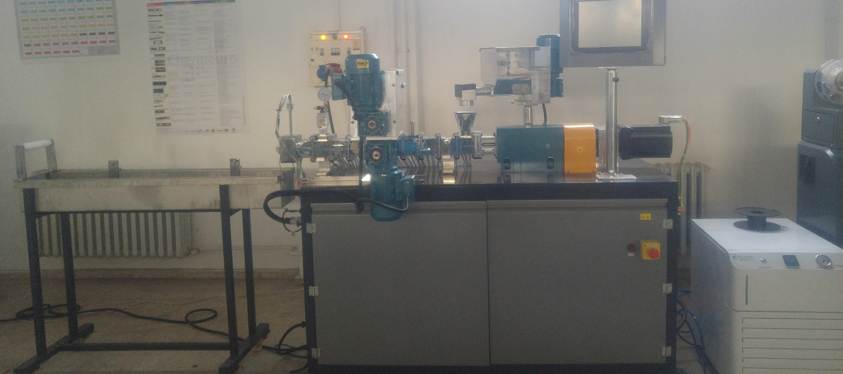
Industrial Design Engineering
Polymer Development Lab.

Slide 26
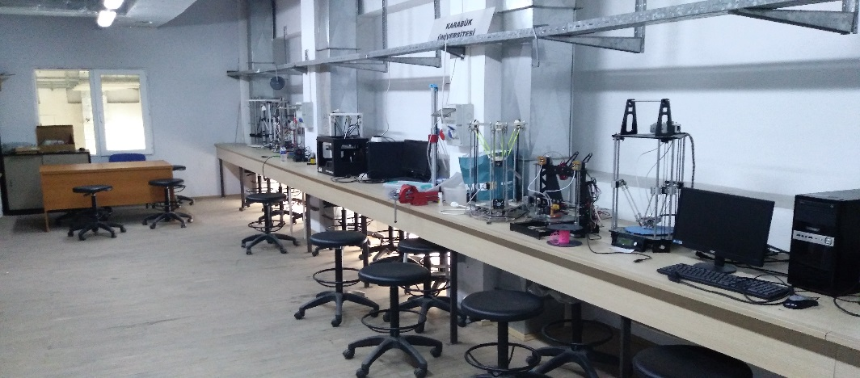
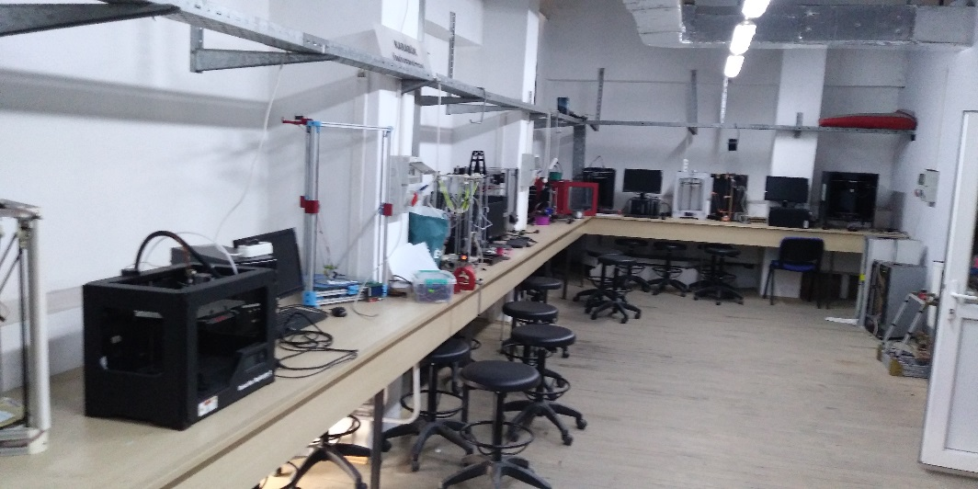
Industrial Design Engineering
Product Development Lab.

Slide 27
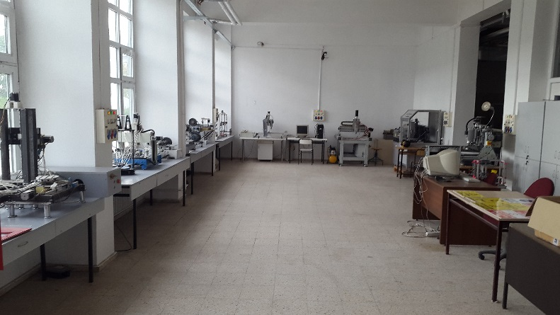
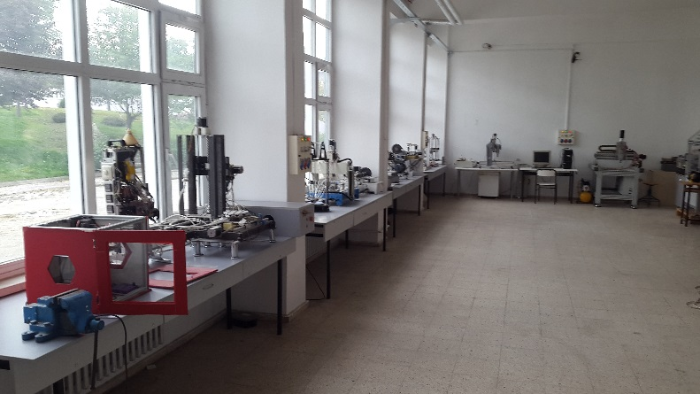
Industrial Design Engineering
3D Printer Lab.

Slide 28
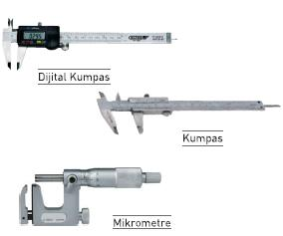
Industrial Design Engineering
Measuring Lab.

Slide 29
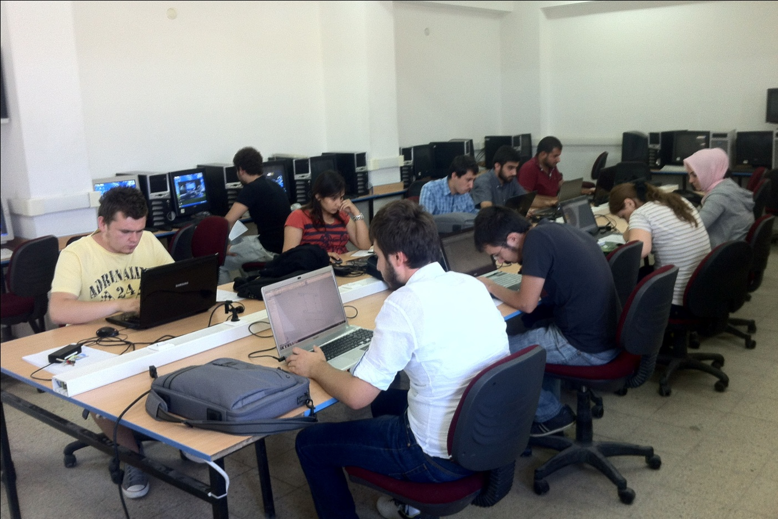
Industrial Design Engineering
CAD/CAM Lab.

Slide 30
Projects
Design and Production of Metal Foam
Design of Seramic 3D Printer
Design and Prototype of Bio 3D Printer
Production of Carbon Reinforced 3D Printer Filament
Design and Prototype of Laser 3D Printer
Wood Reinforced Filament Production
Digital Image Correlation Applications
Hot Metal Forming Applications

Slide 31
Industrial Design Engineering
Contact Information
Postal address:
Karabuk University Faculty of Technology
Industrial Design Engineering Department
Demir Çelik Kampüsü 78050 KARABÜK
Department web page:
http://teknoloji.karabuk.edu.tr/endustriyeltasarim-en
E-mail: teknolojifakultesi@karabuk.edu.tr

