Slide 1

KARABUK UNIVERSITY
Faculty of Technology
Prof. Dr. Ali GÜNGÖR
DEAN
Assoc. Prof. Dr. Tansel TUNÇAY Assist. Prof. Dr. Mehmet ŞİMŞİR
Vice Dean Vice Dean

Slide 2
About the Technology Faculties
Technology faculties in Turkey were established in November 2009.
Technology faculty curriculum has more practical courses than engineering faculty.
Our aim is to train engineering students with more practical skills for the sector’s needs.
Our graduates receive engineering degree.
Our engineers can be a member of affiliated chambers of Union of Chambers of Turkish Engineers and Architects.

Slide 3
Vision
Our vision is to educate and graduate engineers with the following abilities and skills;
sector’s needs,
sensitive about the country issues,
answer the needs of society with their talents,
implement what they learned,
take responsibility,
competitive and innovative,
follow and direct technological development,
respectful to ethical values and sensitive about environment and society.

Slide 4
Mission of Technology Faculty
Our mission is to train engineers with the following abilitiy and skills;
productive,
qualified,
professional savvy,
researchers,
having the ability to practice well beside theoretical knowledge,
perform well in industry,
design new and innovative products,
participate research and development activities,
sensible about environment and society,
having ethics conscious,
taking responsibility.

Slide 6
DEPARTMENTS
Energy Systems Engineering
Industrial Design Engineering
Manufacturing Engineering
Mechatronics Engineering

Slide 7
Number of students
Name of Departments | Name of Programmes | 1 | 2 | 3 | 4 | Total
Industrial Design Engineering | Industrial Design Engineering (VHS.) | 1 | 16 | 10 | 33 | 60
 | Industrial Design Engineering | 50 | 40 | 63 | 63 | 216
 | DM - Industrial Design Engineering | 0 | 0 | 0 | 3 | 3
 | Total | 51 | 56 | 73 | 99 | 279
Energy Systems Engineering | DM– Energy Systems Engineering | 0 | 1 | 0 | 9 | 10
 | Energy Systems Engineering | 54 | 70 | 93 | 105 | 322
 | Energy Systems Engineering(II) | 10 | 15 | 81 | 109 | 215
 | Energy Systems Engineering(VHS) | 1 | 15 | 26 | 53 | 95
 | Energy Systems Engineering (II) (VHS) | 1 | 19 | 26 | 26 | 72
 | DM - Energy Systems Engineering (II) | 0 | 0 | 0 | 2 | 2
 | Total | 66 | 120 | 226 | 304 | 716
Manufacturing Engineering | Manufacturing Engineering | 10 | 21 | 94 | 128 | 253
 | Manufacturing Engineering (II) | 0 | 3 | 5 | 51 | 59
 | Manufacturing Engineering (VHS) | 0 | 10 | 12 | 50 | 72
 | Manufacturing Engineering (II) (VHS) | 0 | 0 | 1 | 11 | 12
 | DM - Manufacturing Engineering | 0 | 0 | 0 | 2 | 2
 | Total | 10 | 34 | 112 | 242 | 398
Mechatronics Engineering | Mechatronics Engineering (II) | 55 | 45 | 100 | 105 | 305
 | Mechatronics Engineering (VHS) | 13 | 20 | 30 | 42 | 105
 | Mechatronics Engineering (II) (VHS) | 3 | 14 | 27 | 24 | 68
 | DM - Mechatronics Engineering | 0 | 0 | 0 | 13 | 13
 | Mechatronics Engineering | 99 | 64 | 97 | 153 | 413
 | DM- Mekatronik Mühendisliği (II) | 0 | 0 | 0 | 2 | 2
 | Total | 170 | 143 | 254 | 339 | 906
 | TOPLAM | 297 | 353 | 665 | 984 | 2299
VHS: Vocational high school
DM: Double major

Slide 8
Academic Staff
Title | Number
Prof. Dr. | 15
Assoc. Prof. Dr. | 7
Assist. Prof. Dr. | 21
Research Asistant | 21
Total | 64
Administrative Staff: 14

Slide 9

Departments

Slide 10

ENERJİ SİSTEMLERİ MÜHENDİSLİĞİ

Slide 11
Working Areas
All areas related to energy systems and technologies in the private sectors,
Mechanics - Plumbing (heating, cooling, ventilation),
Ministry of Energy and Natural Resources,
Energy Market Regulatory Authority (EPDK),
General Directorate of Petroleum Affairs (PİGM),
Mineral Research and Exploration Institute(MTA),
Boron Institute,
Electricity Generation Inc. (Eüaş),
Turkey Pipeline Transportation Inc.

Slide 12


Slide 13
Working Areas
System installation, system maintenance and process improvement in all types of companies,
Companies that design and manufacture systems such as military mobile air and land vehicles, intelligent weapon systems, intelligent defense systems,
Companies developing automation systems and any kind of process control system,
Companies developing electronic cards and software,
Companies developing robotic technology,
Companies that develop and use high technology in the fields of automotive, biomedical, and agriculture.

Slide 14

İMALAT MÜHENDİSLİĞİ

Slide 15
Working Areas
Potential working areas of manufacturing engineers;
Automotive,
Aviation and space,
White goods,
Advanced materials technologies,
Iron and steel industry,
Foundries,
Machining,
Product design,
Companies manufacturing light metals and alloys,
Companies manufacturing ceramic and composite materials.

Slide 16
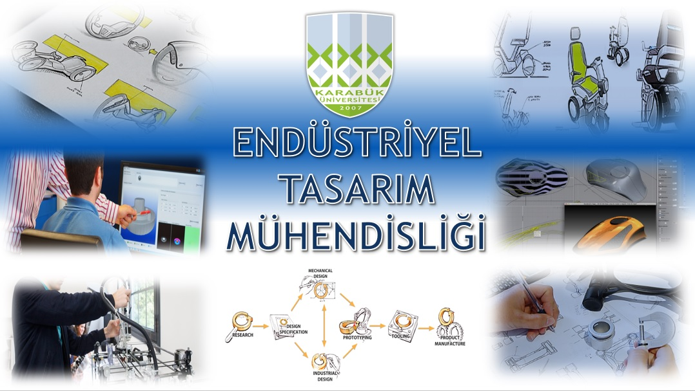
ENDÜSTRİYEL TASARIM MÜHENDİSLİĞİ

Slide 17
Working Areas
Designing, Modeling and Analysis of Mechanical Systems of Air, Land, and Sea Vehicles,
Design, Analysis and Modeling of Industrial Plant Systems,
Industrial Robot Design, Modeling and Analysis,
Design, Modeling and Analysis of CNC Systems,
Design, Modeling and Analysis of Industrial Plastics Molding and Production Processes,
Design, Modeling and Analysis of Industrial Metal Mold and Production Processes,
Industrial Transport Systems Design, Modeling and Analysis,
Manufacturing Industrial Machines, Modeling, Analysis, Production,
Automotive Design, Modeling and Analysis,
Furniture, Furniture Production Machinery, Wood Products Design, Modeling and Analysis,
Railway Systems Design and Production Processes,
Biomedical Systems Design and Production Processes,
Elevator Systems Design and Production Processes,
Design and Production Processes of Cable Car Systems,
Wind Turbines and Energy Systems Design and Production Processes.

Slide 18
Classrooms
2 Technical drawing room
5 Computer laboratories
12 Hall
8 Classroom

Slide 19
Technical Drawing Classroom

Slide 20
Laboratories
Mechatronics | Energy Systems | Manfacturing | Industrial Design
Robotics | PV systems | Metallography | 3D Printers
Computer | Technical Drawing | Machining | CAD-CAM
Hydraulic and Pneumatic | Environmental | Welding | Robotics
Computer hardware | Heating | Casting | Measurement and Control
Electronics | Fluid mechanics | Heat treatment
Basic electric | Wind energy | Mechanical Test
Automotive | Fuel test

Slide 21
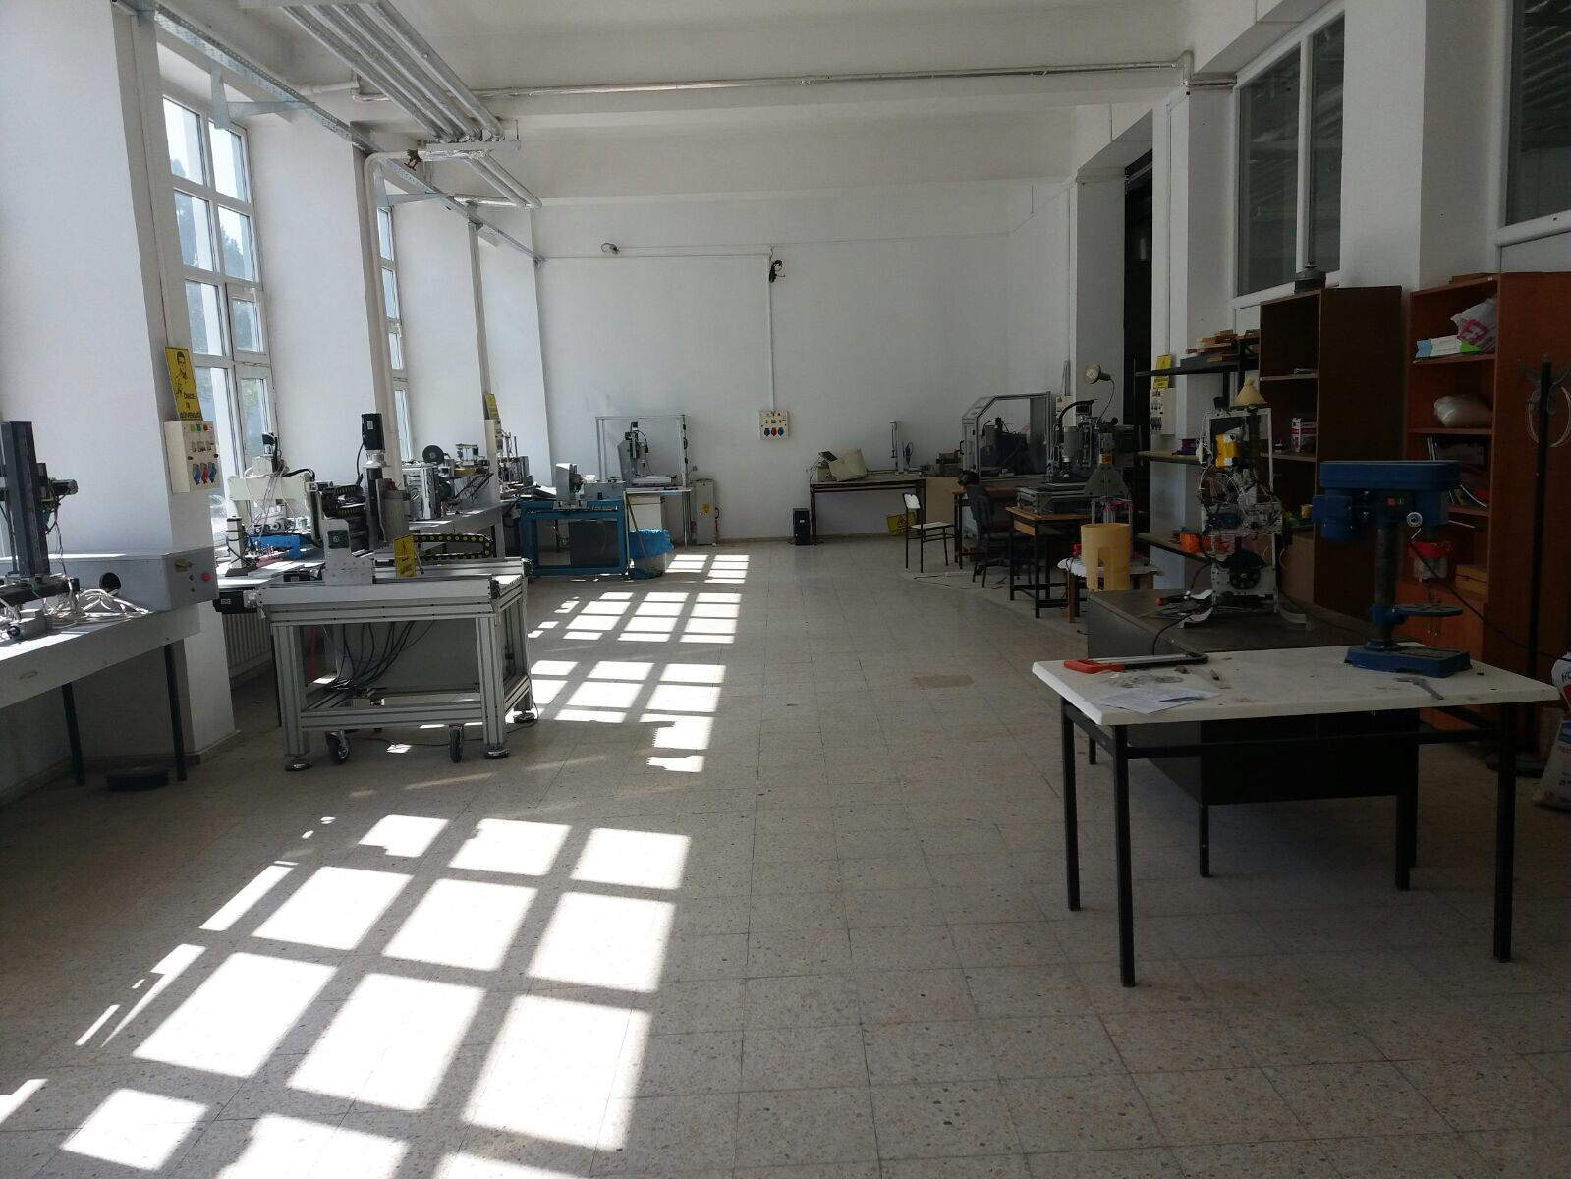
Industrial Design Engineering Laboratory

Slide 22
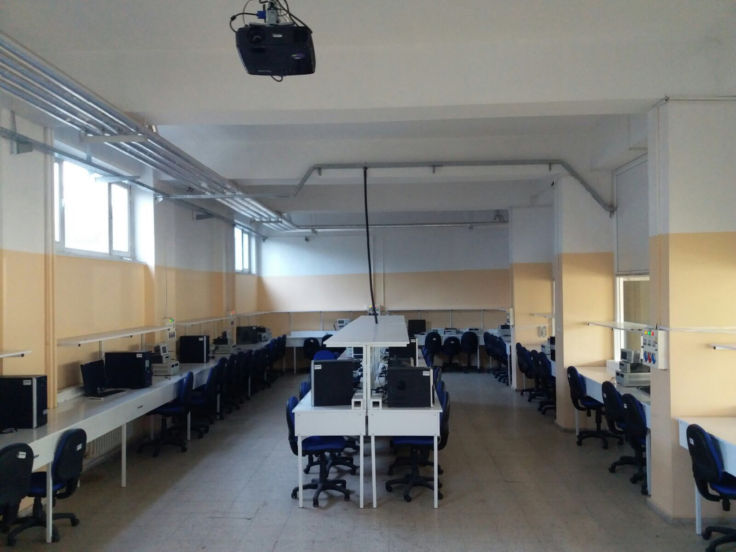
Mechatronic Engineering Laboratory

Slide 23
Energy Systems Engineering Laboratory

Slide 24
Manufacturing Engineering Laboratory

Slide 25
Manufacturing Engineering Laboratory

Slide 26
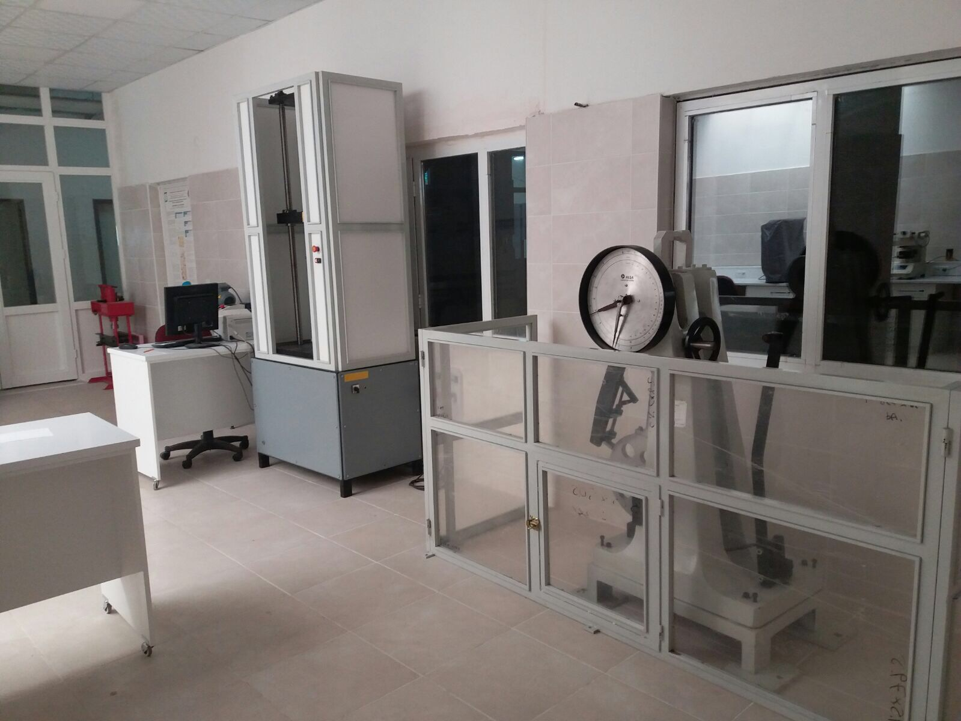
Mechanic Test Laboratory

Slide 27
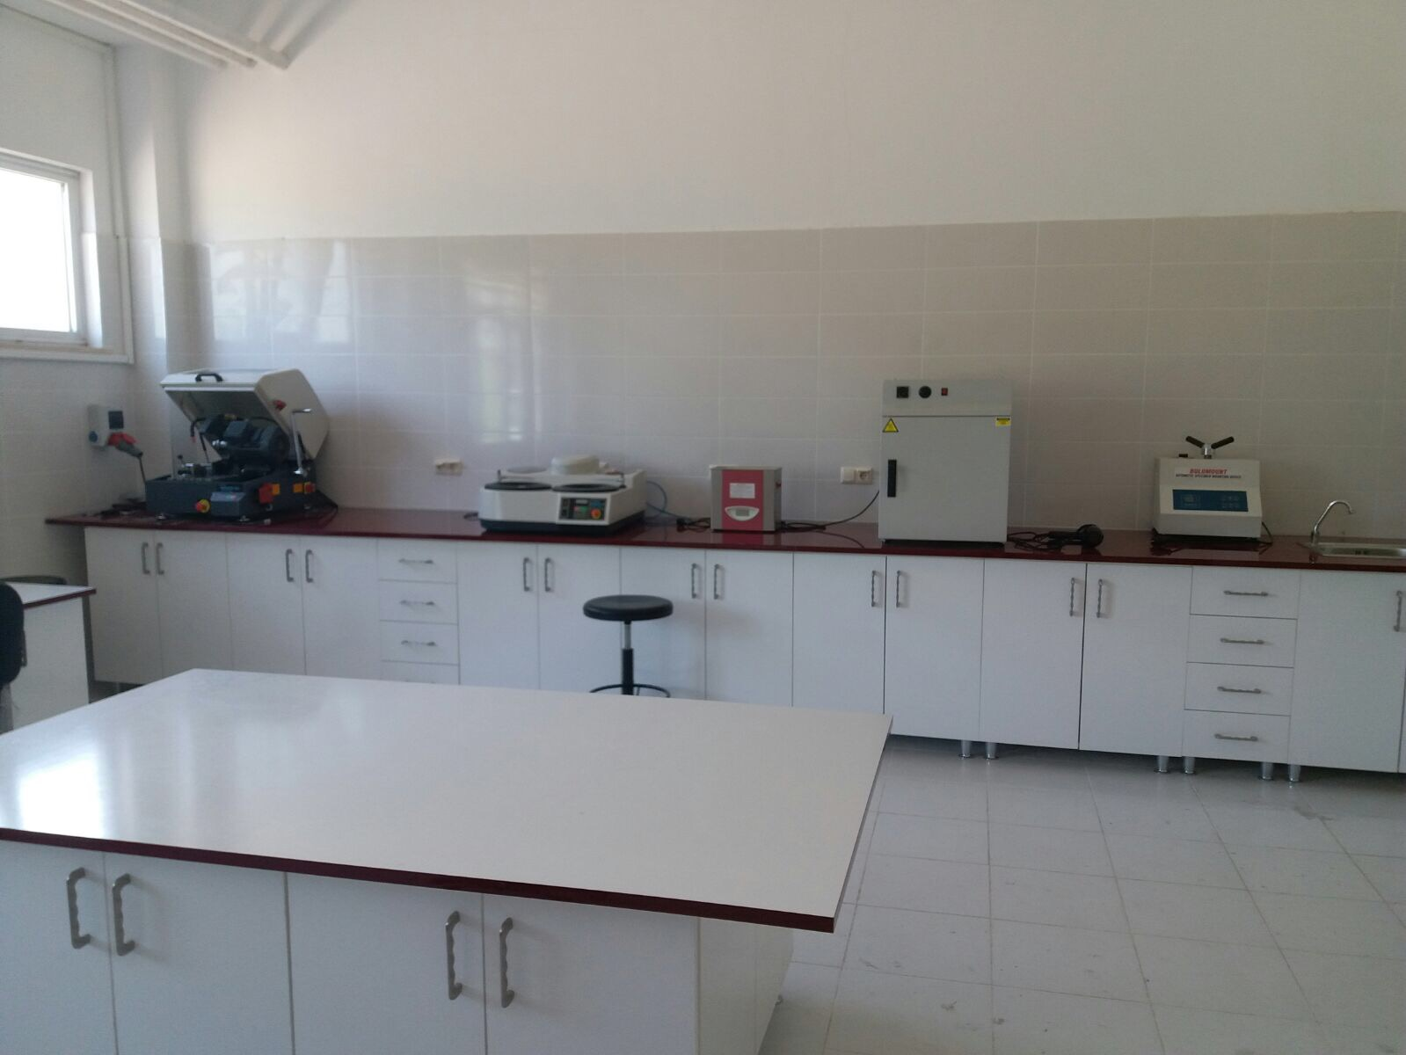
Metallography Laboratory

Slide 28
7+1 Workplace Education System

Slide 29

7+1 Workplace Education
Technology Faculty adapted 7+1 workplace education system and all departments prepared education curriculum.
The aim is to educate technology faculty students as an engineer who knows application and to come to an active and privileged position in the market.
Our students will complete 7 semesters of theoretical education as well as one semester of workplace education.
Students will be equipped with useful knowledge and technology with workplace training during 1 semester workplace education.
They will have opportunity to unify their theoretical knowledge and industrial practice.

Slide 30
Advantages of 7+1 Workplace Education
Many important values such as business ethics, problem solving ability and experience that are not given in the formal education conditions will be given to the students.
Disruptions and broken relationships in the industry-school-student cycle will be eliminated.
It will ensure that our young population, the most influential force of our country, is highly qualified and well educated.
Thus, the University - Industry cooperation will be based on solid foundations and research and development activities will be more productive.

Slide 31
Number of Projects
Karabuk University (last 5 years projects)
Project Types | Number of Projects | Project Budgets
TÜBİTAK (Finished) | 18 | 1.004.653,10 ₺
TÜBİTAK (Continue) | 12 | 15.303.635,55 ₺
SAN-TEZ | 4 | 925.132,74 ₺
BAP | 98 | 659.653,97 ₺
DÖNER SERMAYE PROJELERİ | 13 | 565.925,00 ₺
AVRUPA BİRLİĞİ | 3 | 1.333.438,00 €
DPT | 1 | 16.504.000,00 ₺

Slide 32
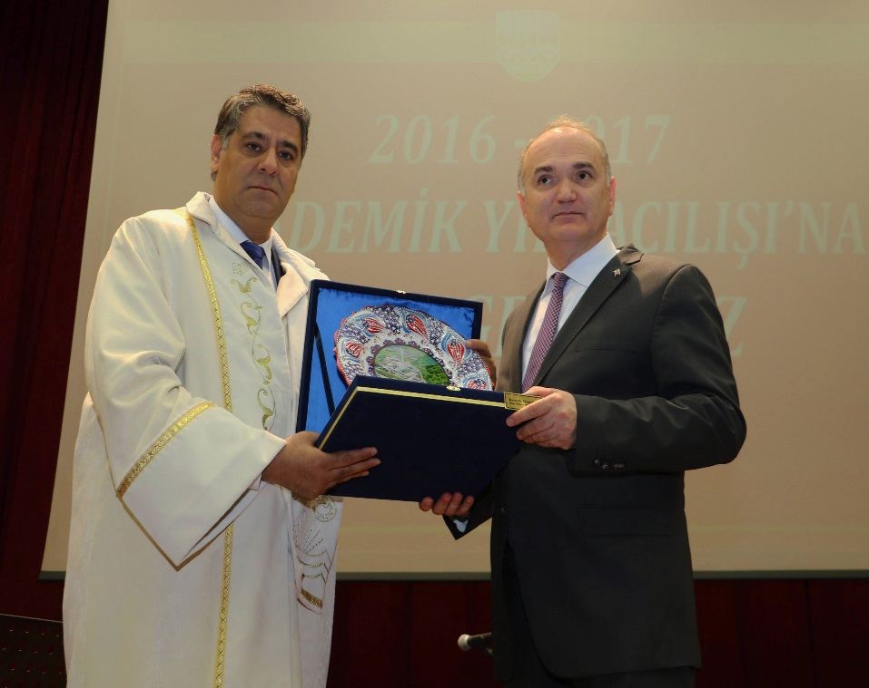
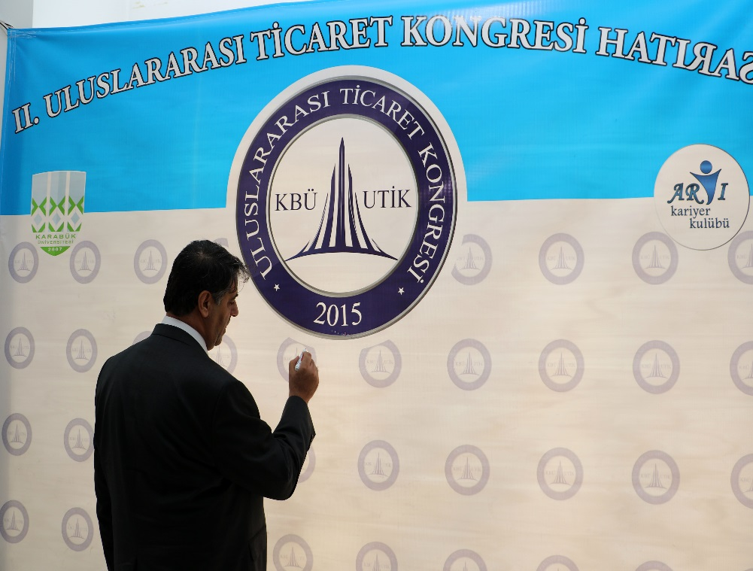
Established in 2007, Karabük University has gained a place among the important institutions in our country by achieving the success of reaching to the number of students who grew with great acceleration and exceeded 50.000. With its growth rate and quality of education, it has been awarded many important prizes in the national and international arena.

Slide 33

Thank you

