Slide 1
Prof. Dr. Ali GÜNGÖR
Dean
Vice Deans
Assist. Prof. Dr. Mehmet ŞİMŞİR
Assist. Prof. Dr. Alper ERGÜN

Slide 2
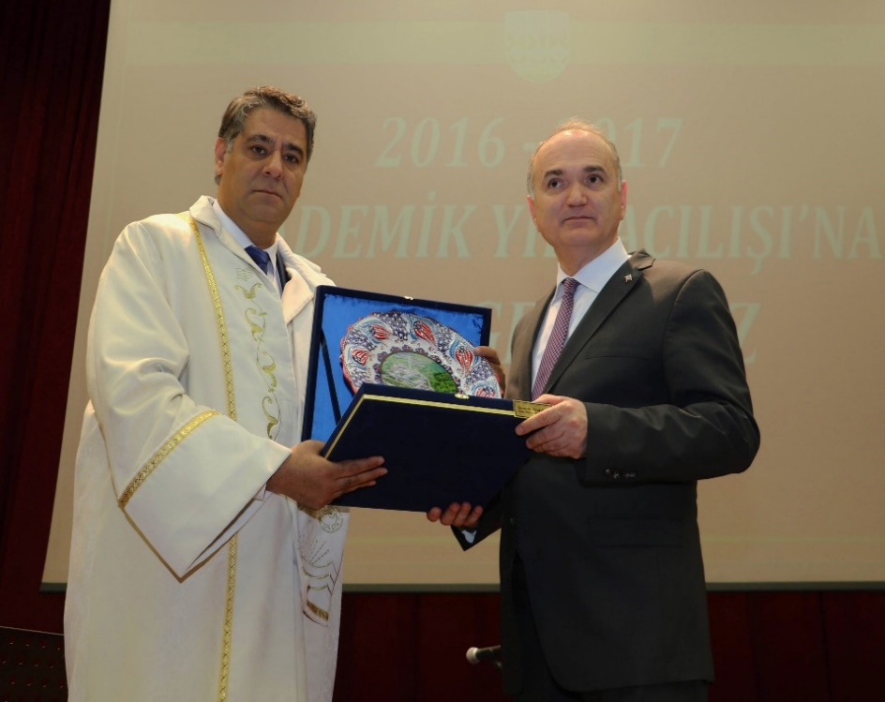
Karabuk University, established in 2007, is one of the biggest institutions in our country with its more than 50000 students.
With its high growth rate and quality of education, it has been awarded many important prizes in the national and international arena.
Karabuk University has managed to take place in “World’s Best 1000 universities” of Times Higher Education (THE) list for 2020. In this ranking list, there are only 11 universities from Turkey and Karabuk University is 10th. among the national universities in the list and not based in Ankara or Istanbul.

Slide 3
About the Technology Faculties
Technology faculties in Turkey were established in November 2009.
Our aim is to train engineering students with more practical skills for the sector’s needs.
Technology faculty curriculums have more practical courses than engineering faculty.
Our graduates receive engineering degree.
Our engineers can be a member of affiliated chambers of Union of Chambers of Turkish Engineers and Architects.

Slide 4
Vision
to meet sector’s needs,
to be sensitive about the country issues,
to answer the needs of society with their talents,
to implement what they learned,
to take responsibility,
to be competitive and innovative,
to follow and direct technological development,
to be respectful to ethical values and sensitive about environment and society.

Slide 5
Mission of Technology Faculty
to be productive,
to be qualified,
to be professional savvy,
to be a good researcher,
to have ability to practice well beside theoretical knowledge,
to perform well in industry,
to design new and innovative products,
to participate research and development activities,
to be sensible about environment and society,
to have ethics conscious,
to take responsibility.

Slide 6
DEPARTMENTS
Energy Systems Engineering
Industrial Design Engineering
Manufacturing Engineering
Mechatronics Engineering
Electrical Engineering

Slide 7
Academic Staff
Title | Number
Prof. Dr. | 17
Assoc. Prof. Dr. | 10
Assist. Prof. Dr. | 17
Research Asistant | 18
Total | 62
Administrative Staff: 22

Slide 8
FACULTY OF TECHNOLOGY GENERAL STUDENT DISTRIBUTION BY DEPARTMENT(11.02.2020)
Department Name | Turkish Language School | 1st. Class | 2nd. Class | 3rd. Class | 4th. Class | Total Number of Students
INDUSTRIAL DESIGN ENG. | 25 | 29 | 39 | 31 | 115 | 239
ENERGY SYSTEMS ENG. | 58 | 52 | 52 | 57 | 265 | 484
MANUFACTURING ENG. | 10 | 16 | 14 | 7 | 136 | 183
MECHATRONICS ENG. | 32 | 119 | 135 | 127 | 369 | 782
TOTAL | 125 | 216 | 240 | 222 | 885 | 1688
 |  | Nationality | Girl | Male |  | Total
 |  | Turkish | 202 | 1117 |  | 1319
 |  | Foreign | 46 | 323 |  | 369
 |  | Total | 248 | 1440 |  | 1688
FOREIGN STUDENT DISTRIBUTION
Department Name | Turkish Language School | 1st. Class | 2nd. Class | 3rd. Class | 4th. Class | Total Number of Foreign Students
INDUSTRIAL DESIGN ENG. | 23 | 15 | 15 | 9 | 3 | 65
ENERGY SYSTEMS ENG. | 56 | 41 | 29 | 7 | 3 | 136
MANUFACTURING ENG. | 10 | 10 | 7 | 1 | 1 | 29
MECHATRONICS ENG. | 32 | 59 | 38 | 7 | 3 | 139
TOTAL (Foreign Students) | 121 | 125 | 89 | 24 | 10 | 369
STUDENT in 2nd. EDUCATION PROGRAMS
Department Name | Turkish Language School | 1st. Class | 2nd. Class | 3rd. Class | 4th. Class | Total Number of Students
ENERGY SYSTEMS ENG. | 0 | 2 | 5 | 10 | 88 | 105
MANUFACTURING ENG. | 0 | 0 | 1 | 3 | 30 | 34
MECHATRONICS ENG. | 2 | 16 | 28 | 45 | 160 | 251
TOTAL (2nd education) | 2 | 18 | 34 | 58 | 278 | 390

Slide 9
7+1 Workplace Education and Workplace Practice

Slide 10
The aim is to educate technology faculty students as engineers who know application and to bring them active and privileged positions in the market.
Our students will complete 7 semesters of theoretical education as well as one semester of workplace education.
It is expected that our students will be equipped with more practical skills and knowledge with workplace education.
They will have opportunity to unify their theoretical knowledge and industrial practice.

Slide 11
Many important values such as business ethics and experience that are not given in the formal education will be gained during workplace education.
Workplace education also contributes to fix disruptions and broken relationships in the industry-school-student cycle.
It will ensure that our young population, the most influential force of our country, is highly qualified and well educated.
With the workplace education, university-industry cooperation can be set on solid foundations and consequently, research and development activities can be more productive.

Slide 12

Graduate Programs
Master of Science Degree
Admission and graduation requirements
  To have Bachelor’s Degree
  To pass foreing language exam
  To pass science exam given by the department
  To take 21 credits (60 ECTS) courses and complete them successfully
  To prepare Master of Science thesis
  To be successful from thesis defence

Slide 13
Graduate Programs
Doctorate (Ph.D.) Degree
Admission and graduation requirements
To have Bachelor’s Degree or M.Sc. Degree
To have English Score (TOEFL/YDS (min.55) score)
To pass science exam given by the department
To take 21 Credits (60 ECTS) courses and complete them successfully
To pass Ph.D. Proficiency Exam
To publish a paper in a journal covered by SCI/SCI-Exp. index
To prepare Ph.D. thesis
To be successful from thesis defence

Slide 14

DEPARTMENT OF MANUFACTURING ENGINEERING

Slide 15
Manufacturing Engineering
History
The base of the department extends to the year of 1992 which “Technical Education Faculty” was established.
In 2009 Technical Education Faculty was changed by the government to “Technology Faculty”. Manufacturing Engineering Department was one of the first departments which was started its academic studies at Technology Faculty.

Slide 16
Manufacturing Engineering
Mission
To educate researchers and experts who have high self-confidence and cultural accumulation and the knowledge of foreign language, software and hardware, they can perform design and project studies independantly, perform supervision and control, take responsibility, produce solutions, follow and use the knowledge and applications in their fields and communicate with their collegues.
Notes:
İpucu: Konuşmacı notlarınızı buraya ekleyin.

Slide 17
Manufacturing Engineering
Vision
Today, in rapidly developing technology, it is aimed to educate academic individuals who are able to communicate and collaborate effectively with their stakeholders, internationally recognized, innovative, always developing, leader and educate participatory, sharing, original, aesthetic values and professioanally competent individuals.
Notes:
İpucu: Konuşmacı notlarınızı buraya ekleyin.

Slide 18
Manufacturing Engineering
About the department
Manufacturing engineering is a discipline of engineering dealing with different manufacturing practices and the research and development of systems, processes, machines, tools and equipment.

Slide 19
Manufacturing Engineering
Specialised Research Areas
  Production metallurgy: Casting, powder metallurgy, production of advanced materials (biomaterials, foams etc.).
  Welding and joining of materials: Different types of welding techniques, welding simulation, welding robots, additive manufacturing.
  Machine production: Machining of metals, Computer aided design (CAD), manufacturing (CAM) and engineering (CAE). Surface and precision engineering.
  Mechanical metallurgy: Forming of materials, cold and hot rolling, mechanical behaviours of metals and its alloys.

Slide 20
Manufacturing Engineering
Course Credits (ECTS)
Elective courses: 39
Fundamental courses: 31
Engineering courses: 136
Field courses: 34
Total credits: 240
Credits of theoretical courses: 128
Credits of practical courses: 112

Slide 21
Manufacturing Engineering
Double Major Programs:
Energy Systems Engineering
Mechatronics Engineering
Industrial Design Engineering

Slide 22
Manufacturing Engineering
Graduate Programs
Master’s and Ph.D Degree
  Manufacturing Engineering

Slide 23
Manufacturing Engineering
Faculty Members
Number of Professor: 8
Number of Associate Professor: 4
Number of Assistant Professor: 3
Number of Research Assistant: 7

Slide 24

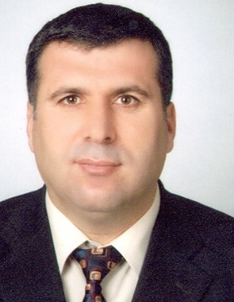

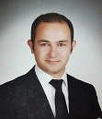
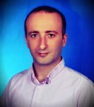
Administrative Staff
Prof. Dr. Halil DEMİR
Head of Department
Assoc. Prof. Dr. Yakup KAYA
Vice Head of Department
Assist. Prof. Dr. Ali KALYON
Vice Head of Department

Slide 25
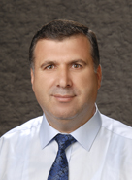
Academic Staff
Prof. Dr. Halil DEMİR
E-mail: hdemir@karabuk.edu.tr
Phone: 3704187100 / 1331
Address: Karabuk / Turkey
Research Interests
Machine design and manufacturing, Die design and manufacturing, Grinding
Recent Academic Studies
Yaka, H., Demir, H., Gök A., " Optımızatıon of The Cuttıng Parameters Affectıng The Surface Roughness on Free Form Surfaces" Sigma Journal of Engineering and Natural Sciences 2017, Volume: 35, Issue: 2, (JUN 2017), pp:323-331.

Slide 26
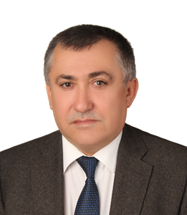
Academic Staff
Prof. Dr. Ramazan KAÇAR
E-mail: sgunduz@karabuk.edu.tr
Phone: 3704187100 / 1010
Address: Karabuk / Turkey
Research Interests
Welding methods, Resistance welding, Stainless steels, Ageing
Recent Academic Studies
Ahmet Bülbül, Ramazan Kaçar, “Factors Affecting Kinetics of Strain Aging in S275JRC Steel” Materials Research. 2017; 20 (1): 210-217.
Havva Kazdal Zeytin, Hayriye Ertek Emre, Ramazan Kaçar “Properties of Resistance Spot Welded TWIP Steels”, Metals, 2017, 7, 14.
Ahmet Bülbül, Hayriye Ertek Emre, Ramazan Kaçar, “The effect of strain ageing on the fatigue properties of S275JRC Steel” Materials Testing, 59,3, 253-257, 2017.

Slide 27
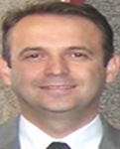
Academic Staff
Prof. Dr. Süleyman Gündüz
E-mail: sgunduz@karabuk.edu.tr
Phone: 3704187100 / 1325
Address: Karabuk / Turkey
Research Interests
Metallic materials, Mechanic metallurgy, Welding technology,
Powder metallurgy
Recent Academic Studies
D. Özdemirler, S. Gündüz, M.A. Erden, Influence of NbC Addition on the Sintering Behaviour of Medium Carbon PM Steels, Metals, 7, (121), 1-11, 2017.
S. Gündüz, H. Karabulut, M. Türkmen, M. A. Erden, An investigation on wear behaviour of powder metallurgy microalloyed steels, Mechanika, 23 (4), 574-580, 2017.
G.A. Muhamed, S. Gündüz, M.A. Erden, D. Taştemur, Dynamic Strain Aging Behaviour in AISI 316 L Austenitic Stainless Steel under As-Received and As-Welded Conditions, Metals, 7, 362, 2017.

Slide 28
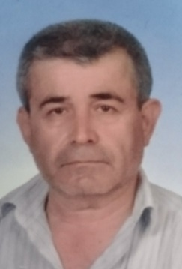
Academic Staff
Prof. Dr. Dursun ÖZYÜREK
E-mail: dozyurek@karabuk.edu.tr
Phone: 3704187100 / 1326
Address: Karabuk / Turkey
Research Interests
Powder metallurgy, Casting technology, Mechanic properties and Characterisations, Aluminium and alloys
Recent Academic Studies
İ. Şimşek, D. Özyürek, “An investigation of the effect of high-energy milling time of Ti6Al4V biomaterial on the wear performance in the simulated body fluid environment”, Powder Metallurgy, 60 (5), (2017) 384-392.
M. Yıldırım, D. Özyürek, “An investigation of wear behaviors of AA7075 Al hybrid composites”, High Temperature Materials and Processes, 37 (6), (2018).

Slide 29
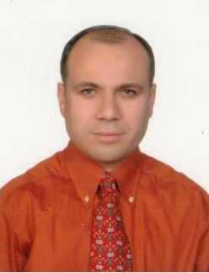
Academic Staff
Prof. Dr. Nizamettin KAHRAMAN
E-mail: nkahraman@karabuk.edu.tr
Phone: 3704187100 / 1328
Address: Karabuk / Turkey
Research Interests
Welding technology, Welding metallurgy, Solid state welding abilities of ferrous and non-ferrous materials
Recent Academic Studies
Ali Yürük, Nizamettin Kahraman, Weld zone characterization of stainless steel joined through electric resistance spot welding, The International Journal of Advanced Manufacturing Technology, (2017) 92(5-8):2975-2986.
Kaya Yakup, Kahraman Nizamettin, Durgutlu Ahmet, Gülenç Behçet, Investigation of the Microstructural, Mechanical and Corrosion Properties of Grade A Ship Steel-Duplex Stainless Steel Composites Produced via Explosive Welding. Metallurgical and Materials Transactions A, 48A (8) (2017), 3721-3733

Slide 30
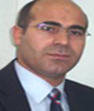
Academic Staff
Prof. Dr. Mustafa BOZ
E-mail: sgunduz@karabuk.edu.tr
Phone: 3704187100 / 1321
Address: Karabuk / Turkey
Research Interests
Powder metallurgy, Friction and wear,
Atomisation and powder production
Recent Academic Studies
Akkaş M, Çetin T, Boz M, The Effect of Gas Pressure on Powder Size and Morphology in the Production of AZ91 Powder by Gas Atomization, Archives of Metallurgy and Materials, 2017.

Slide 31
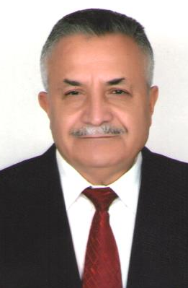
Academic Staff
Prof. Dr. İsmail KARACAN
E-mail: ikaracan@karabuk.edu.tr
Phone: 3704187100 / 1114
Address: Karabuk / Turkey
Research Interests
CNC, Modern manufacturing processes, Industrial Hydrolic pnomatic control, Grinding and tool sharpening
Recent Academic Studies

Slide 32
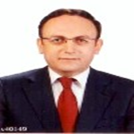
Academic Staff
Prof. Dr. Melik ÇETİN
E-mail: mcetin@karabuk.edu.tr
Phone: 3704187100 / 1332
Address: Karabuk / Turkey
Research Interests
Casting technology, Thermomechanical processes, Porous and Cellular materials, Al foams, Residual stress measurements of rails
Recent Academic Studies
Bozali,U., Yaşar,M., Çetin,M., Çay,V.Ç., Ali Günen,(2017) “An investigation on wear mechanisms of boronized AISI 4140 steel” Journal of the Balkan Tribological Association (23),1-15.
Turan, M.E., Sun, Y., Aydın F., Çetin, M., (2017), “Residual stress measurement by Cutting and X-ray diffraction method in different shaped rails” Part F: Journal of Rail and Rapid Transit, (In Progress).
Nida KATI, Uğur ÇALIGÜLÜ, Melik ÇETİN, Uğur GENÇSOY,(2017), The Effect of Surface Hardening Process with Induction on Microstructure and Mechanical Properties of GGG40 Cast Irons, Journal of Taibah University for Science (In Progress).

Slide 33
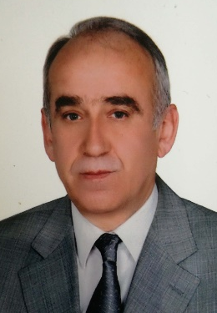
Academic Staff
Assoc. Prof. Dr. Mehmet ÜNAL
E-mail: munal@karabuk.edu.tr
Phone: 3704187100 / 1119
Address: Karabuk / Turkey
Research Interests
Magnesium and alloys, Metallic materials, Light alloys
Recent Academic Studies
Mehmet ÜNAL, Effects of solidification rate and Sb additions on microstructure and mechanical properties of as cast AM60 magnesium alloys, International Journal of Cast Metals Research, 27(2), 80-86.
ErkanKoç, M.BobbyKannan, MehmetÜnal, ErcanCandan, Influence of zinc on the microstructure, mechanical properties and in vitro corrosion behavior of magnesium-zinc binary alloys, Journal Of Alloys And Compounds, 648, 291-296.,

Slide 34
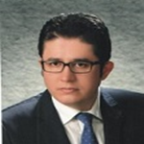
Academic Staff
Assoc. Prof. Dr. Tansel TUNCAY
E-mail: tanseltuncay@karabuk.edu.tr
Phone: 3704187100 / 1103
Address: Karabuk / Turkey
Research Interests
Casting simulations and liquid metal flow and solidification, Al alloys, Sand casting, Metal die casting,
Recent Academic Studies
D. Ozyurek, B. Yavuzer and T. Tuncay (2016) The effects of Cu and Al on dry sliding wear properties of eutectic Sn-9Zn lead-free solder alloy, Journal of Adhesion Science and Technology, 30:15, 1662-1670.
D. Ozyurek, M. Yıldırım, T. Tunçay,” An Investigation of the Effects of Ageing Parameters on Wear Behaviours and Electrical Conductivity of Cu–Co–Be Alloys”., Acta Physica Polonia A, 129 (4), (2016), 559-561.

Slide 35

Academic Staff
Assoc. Prof. Dr. Yakup KAYA
E-mail: ykaya@karabuk.edu.tr
Phone: 3704187100 / 1178
Address: Karabuk / Turkey
Research Interests
Solid state welding technics, welding metallurgy,
Welding of light and non-ferrous metals
Recent Academic Studies
Yakup Kaya, Nizamettin Kahraman, Ahmet Durgutlu And Behçet Gülenç, Investigation of the Microstructural, Mechanical and Corrosion Properties of Grade A Ship SteelDuplex Stainless Steel Composites Produced via Explosive Welding, Metallurgical and Materials Transactions A, İssue 8, 48A, 3721-2711, 2017.
Yakup Kaya, Microstructural, Mechanical and Corrosion Investigations of Ship SteelAluminium Bimetal Composites Produced by Explosive Welding, Journal of Materials Engineering and Performance, Inpress.

Slide 36

Academic Staff
Assist. Prof. Dr. Ali KALYON
E-mail: alikalyon@karabuk.edu.tr
Phone: 3704187100 / 1187
Address: Karabuk / Turkey
Research Interests
Machining, Non-traditional manufacturing methods, CAD-CAM
Recent Academic Studies

Slide 37
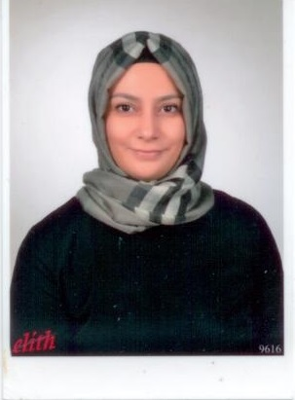
Academic Staff
Assist. Prof. Dr. Hayriye ERTEK EMRE
E-mail: hayriyeertek@karabuk.edu.tr
Phone: 3704187100 / 1091
Address: Karabuk / Turkey
Research Interests
Welding of ferrous and non-ferrous materials, Materials science,
Resistant spot welding
Recent Academic Studies
ERTEK EMRE HAYRİYE,KAÇAR RAMAZAN (2016). Effect of Button Geometry on TRIP800 Steel Resistance Spot Weldment. IJIRSET, 5(12), 164-171. (Yayın No: 3324507)
ERTEK EMRE HAYRİYE,KAÇAR RAMAZAN (2016). Resistance spot weldability of deformed TRIP800 steel. welding journal, 95(3), 77-85. (Yayın No: 2813160)
ERTEK EMRE HAYRİYE,KAÇAR RAMAZAN (2016). Development of weld lobe for resistance spot welded TRIP800 steel and evaluation of fracture mode of its weldment. The International Journal of Advanced Manufacturing Technology, 83(9-12), 1737-1747., Doi: 10.1007/s00170-015-7605-1 (Yayın No: 1701754)

Slide 38
Academic Staff Research Assistants
Res. Assist. Dr. Muhammed ELİTAŞ
Res. Assist. Ahmet Serdar GÜLDİBİ
Res. Assist. Yusuf AYAN
Res. Assist. Talha SUNAR
Res. Assist. Atakan Oğuz OCAK
Res. Assist. Demet TAŞTEMUR
Res. Assist. Öznur DİNCEL
Res. Assist. Samet NOHUTÇU

Slide 39
Manufacturing Engineering
Laboratories;
  Casting Laboratory
  Welding Laboratory
  Metallography Laboratory
  Machining Laboratory
  Materials Testing Laboratory
  Computer Laboratory

Slide 40
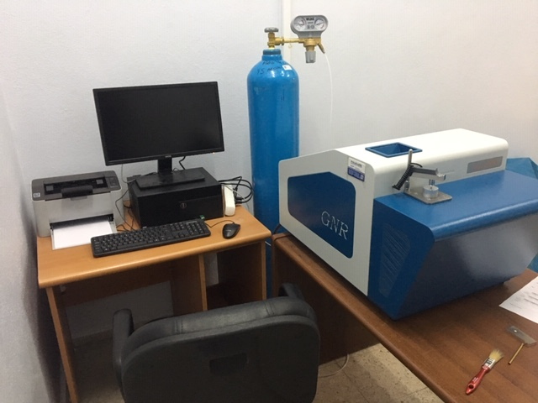
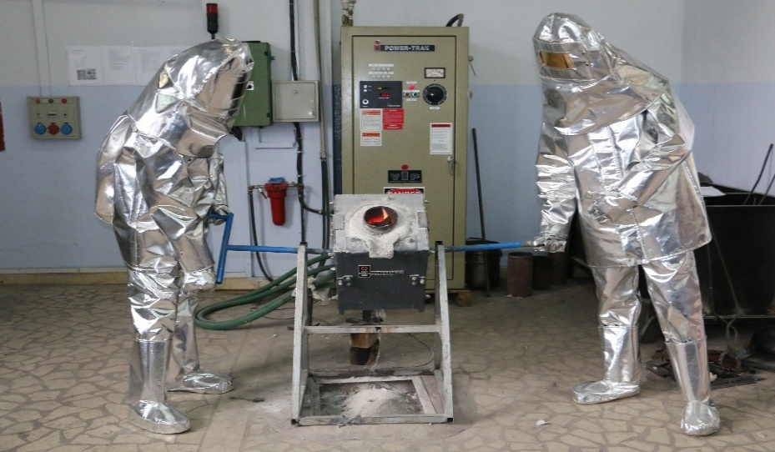
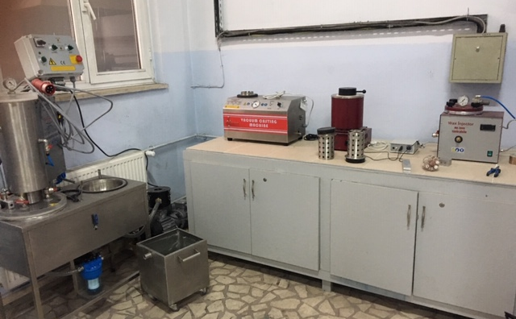
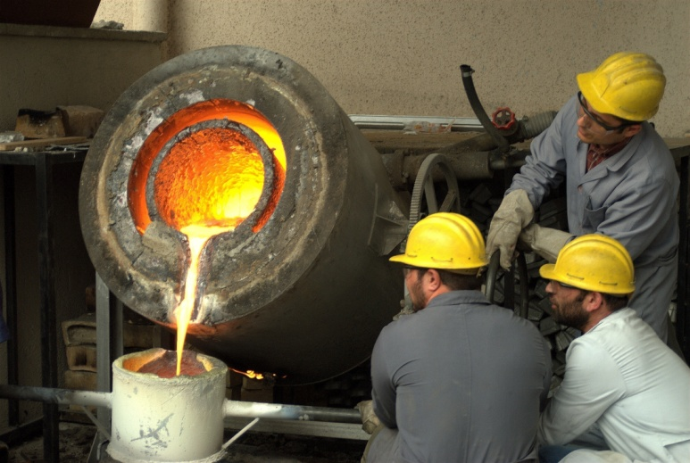
Manufacturing Engineering
Casting Laboratory
Optical emission spectrometry Induction furnace
Investment casting lab. Resistance furnace

Slide 41
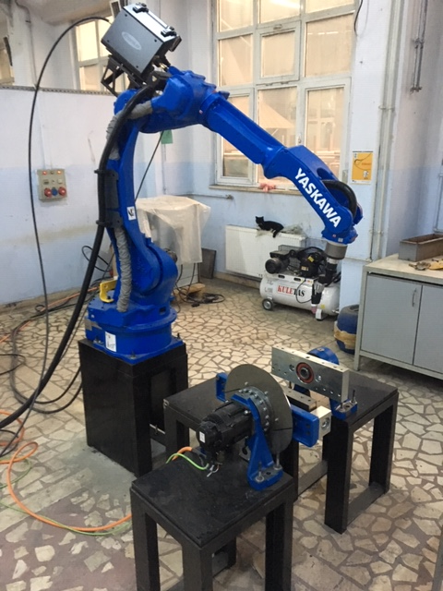
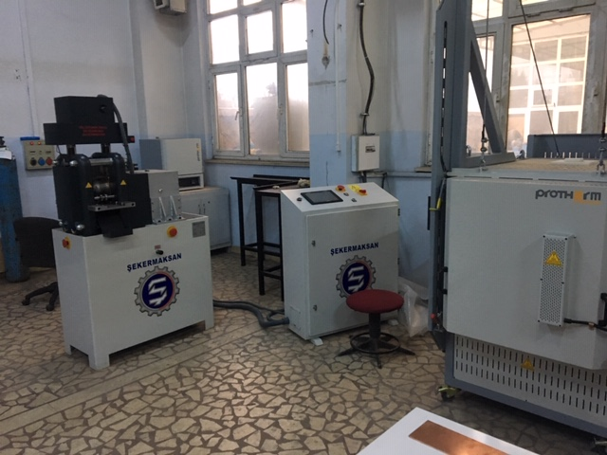
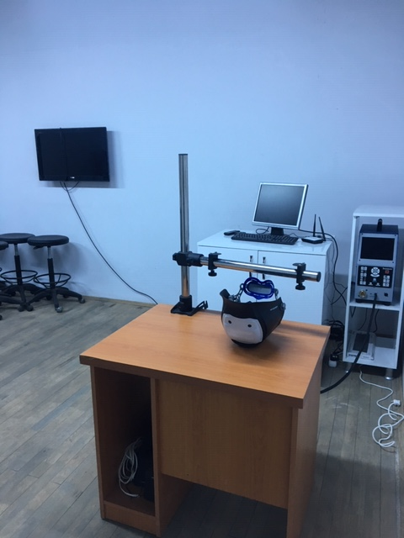
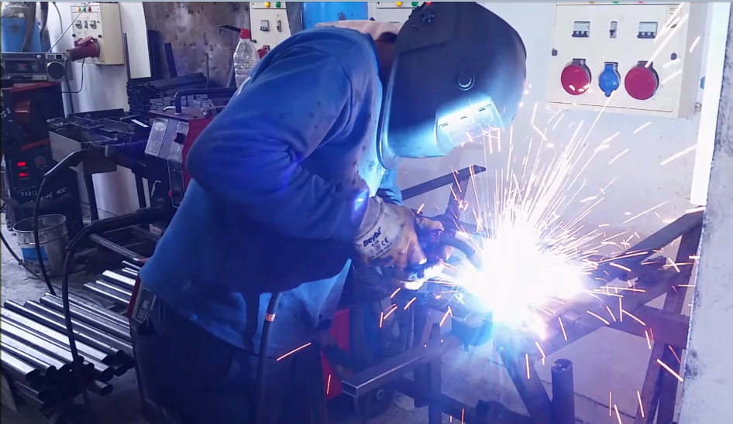
Manufacturing Engineering
Rolling lab.
Welding robotic arm
Welding simulation lab.

Slide 42
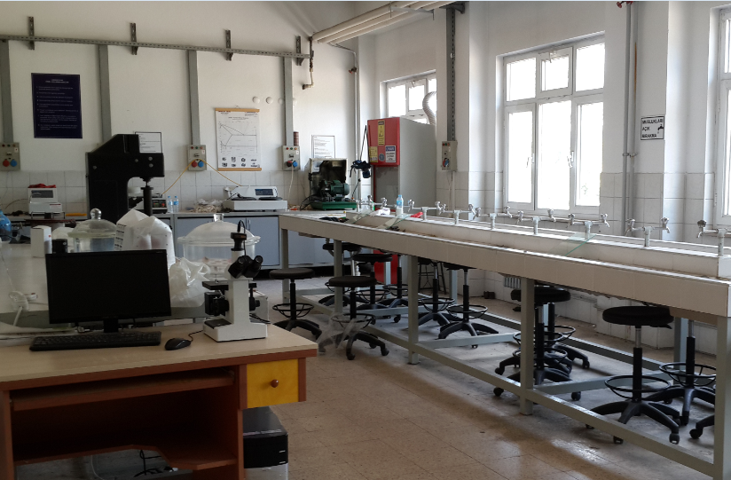
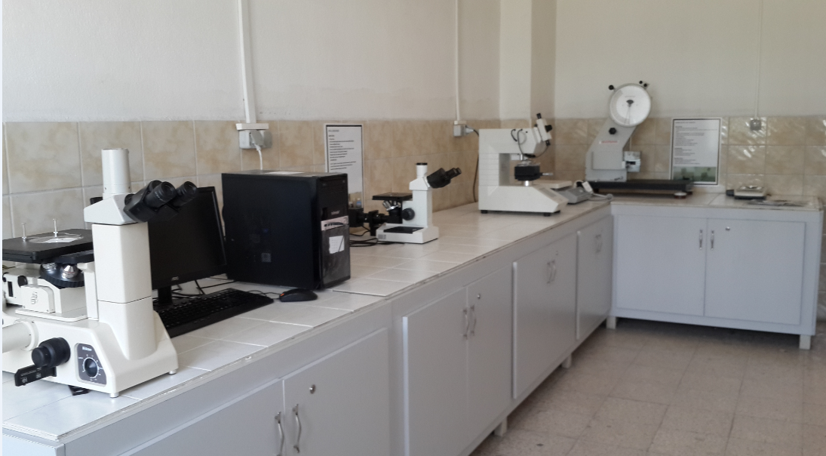
Manufacturing Engineering
Metallography Laboratory

Slide 43
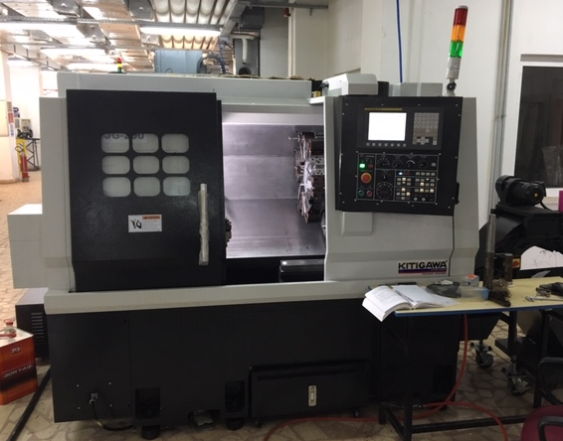
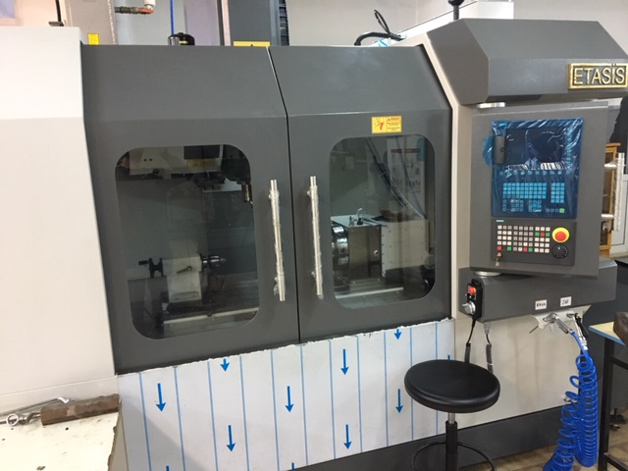
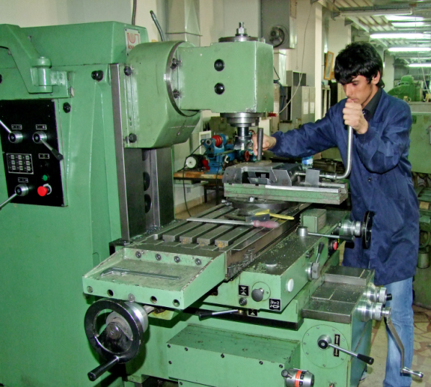
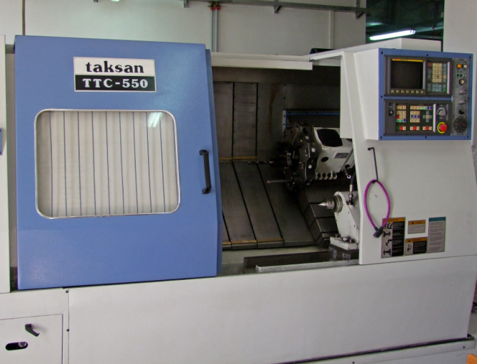
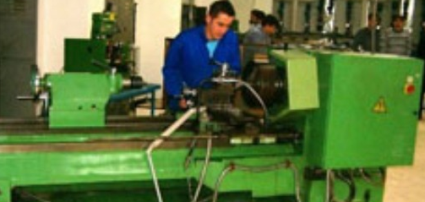
Manufacturing Engineering
Machining Laboratory
CNC Lathe CNC Milling
Other traditional manual machines

Slide 44
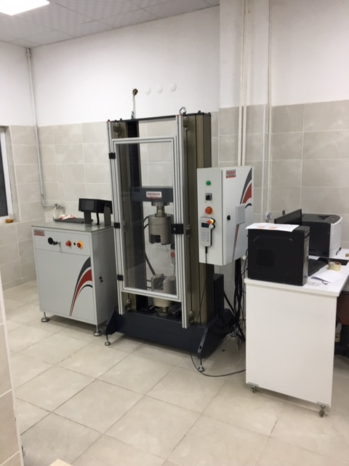
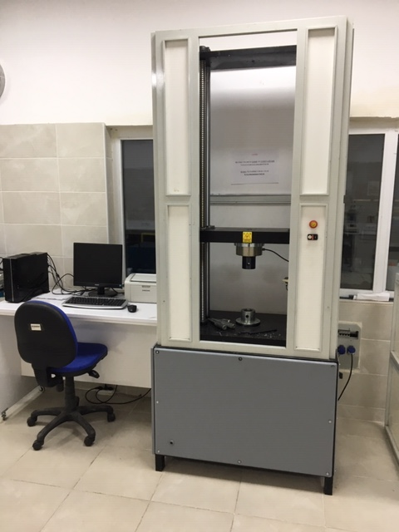
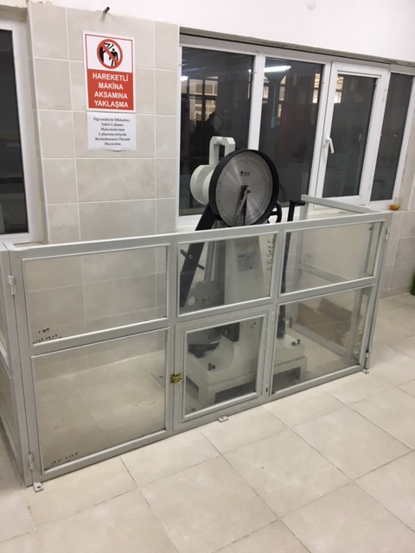
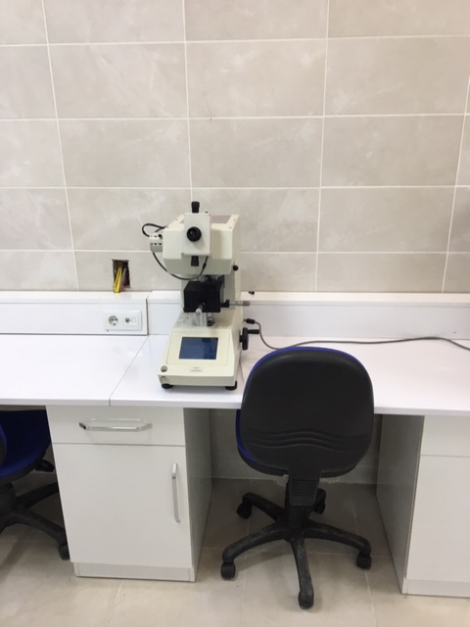
Manufacturing Engineering
Materials Testing Laboratory
RT tension, compression and bending test machines.
Notch-Impact test unit.
Hardness test machine

Slide 45
Projects
TRIP800-DP600 steel plates, Ressistance spot welding ability, KBU-BAP. 2014
Production and characterisation of AZ91 powders via gas atomisation, KBU-BAP-2015.
Investigation of the effects of Cu and Fe addition to Al-Si-Mg alloys.
Production of open celled foams and uniform cellular materials for high performance heat exchanger (Tubitak-215M233-2016)
Hot work tool steel Toolox 44 machinability" 2017 KBÜ-BAP.
İnvestigation of wear and corrosion behaviours of Ti-alloy biomaterials produced via powder metallurgy, KBÜ-BAP-2017.
Investigation of microstructure and mechanical properties of pressure vessel steels joined via submerged arc welding method. KBÜ-BAP 2017
Grade A Ship Blade joining, mechanical and metallographical research, KBÜ-BAP-2017
Powder metallurgy steels with TiN addition, microstructure and mechanical properties K.B.Ü-BAP-2017

Slide 46
Employment Fields
Machine and Manufacturing
Casting and foundry
Automotive, defense and aerospace
Electronic materials
Iron-steel
CNC Systems
CAD-CAM-CAE
Research and Development Center

Slide 47
Manufacturing Engineering
Contact Information
Postal address: Balıklarkayası Mevkii, Demir Çelik Kampüsü, Teknoloji Fakültesi 78050 Karabük/Türkiye
Department web page:teknoloji.karabuk.edu.tr/imalat
E-mail: teknolojifakultesi@karabuk.edu.tr

Slide 48

DEPARTMENT OF ENERGY SYSTEMS ENGINEERING

Slide 49
Energy Systems Engineering
History
The base of the department extends to the year of 1992 which “Technical Education Faculty” was established.
In 2009 Technical Education Faculty was changed by the government to “Technology Faculty” Energy System Engineering Department was one of the first departments which started its academic studies at Technology Faculty.

Slide 50
Energy Systems Engineering
Mission
Our mission is to train social and creative engineers who are fit for teamwork, responsible and sensitive to environment, can successfully take part in design, production, application and research-development studies of industrial and research institutions, possess a systematical approach in solving problems, have leader characteristics and conscience for economical and professional ethics by giving universally theoretical and practical bachelors and master education and on-the-job training in accordance with the ideals of Ataturk, modern and ethical values, crediting the superiority of law; to find solutions to the problems of the national industry by conducting research which produces information and technology in international level.
Notes:
İpucu: Konuşmacı notlarınızı buraya ekleyin.

Slide 51
Energy Systems Engineering
Vision
The vision of our faculty is to become a research institution possessing developed organizational connections with the national and international science and technology world and the industry, a strong institutional identity and culture, which gives education in equivalence with similar faculties of national and international qualified universities. So as to actualize our mission, we aim to become a respected and approved faculty serving its country, consistently updating its research, development, instruction and education infrastructure, having academic staff who prioritize research, modern science and technology along with life-long learning and instruction. The lesson plans and contents of our Faculty of Technology have been developed in according with the needs of the Turkish industry, taking into account the principles of competent engineering (MUDEK- Association for Evaluation and Accreditation of Engineering Programs) and Europe (Erasmus-Socrates) and USA (ABET) education programs.
Notes:
İpucu: Konuşmacı notlarınızı buraya ekleyin.

Slide 52
About Energy Systems Engineering
Energy Systems Engineering Department has two programs in two periods of a day (I. and II. education period).
Educational language of the department is Turkish.
Graduated students have a general range of knowledge and satisfy the requirements of energy workshop, and can work international projects with other colleaques. Design of HVAC systems, new generation renewable energy systems, Nuclear energy, Hydrogen energy and Efficiency analyses of a system are gained by the students along their eduation period.

Slide 53
About Energy Systems Engineering
Specialised Research Areas
Engineering Economics and Energy Efficiency
Wind Energy
Solar Energy
Cooling Systems
Heating, Ventilation and Air Conditioning
Mechanical Installation
Fuel Cells
Hybrid Systems

Slide 54
Energy Systems Engineering
Course Credits (ECTS)
Elective courses: 55
  Technical elective courses: 47
  Social elective courses: 8
Fundamental courses: 35
Engineering courses: 115
Field courses: 35
Total credits: 240
Credits of theoretical courses: 150
Credits of practical courses: 90

Slide 55
Energy Systems Engineering
Double Major Programs
Mechanical Engineering
Manufacturing Engineering
Mechatronics Engineering
Industrial Design Engineering

Slide 56
Energy Systems Engineering
Graduate Programs
Master’s and Ph.D Degree
  Energy Systems Engineering

Slide 57
Energy Systems Engineering
Faculty Members
Number of Professor : 5
Number of Associate Professor: 3
Number of Assistant Professor: 6
Number of Research Assistant : 6

Slide 58
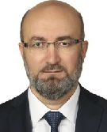
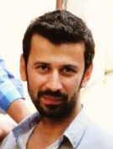
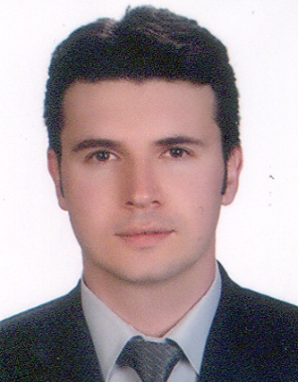
Administrative Staff
Prof.Dr.Mehmet ÖZKAYMAK
Head of Department
Asst.Prof.Dr.Şafak ATAŞ
Vice Head of Department
Asst.Prof.Dr.Bahadır ACAR
Vice Head of Department

Slide 59
Academic Staff
Prof.Dr.MEHMET ÖZKAYMAK
E-mail: mozkaymak@karabuk.edu.tr
Phone:+90 370 418 71 00 / 1300
Address: Karabuk / Turkey
Research Interests
Energy Efficiency, Thermal Energy Systems,Exergy, Renewable Energy Sources
Recent Academic Studies
Özkaymak, M., Tabak, A., Canan, A., Aksay, M. V., İnanç, Ö., & Eruz, Ü. G. (2017). Efficiency And Investment Comparison of Monocrystalline, Polycrystalline, and Thin Film Solar Panel Types at Karabuk Conditions. I-Manager’s Journal on Power Systems Engineering, 5(3), 1–9.
Özkaymak, M., Ceylan, M. A., Okutan, H. C., Atakul, H., Engin, B., Çoşkun, T., & İnanç, Ö. (2017). CO₂ Emission During The Combustion Of Orhaneli Lignite Coal” World Journal Of Engineering, 14(1), 27–34.

Slide 60
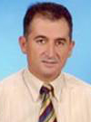
Academic Staff
Prof.Dr. SEZAYİ YILMAZ
E-mail: syilmaz@karabuk.edu.tr
Phone:+90 370 418 71 00 / 1013
Address: Karabuk / Turkey
Research Interests
Solar Energy, Alternative Energy Sources, Thermal Energy Systems
Recent Academic Studies
A.E. GÜREL, İ. CEYLAN, and S. YILMAZ, “Thermodynamıc analysıs of PID controlled fluıdızed bed dryer wıth parabolıc trough collector,” International Journal of Exergy, pp. 0–0, 2015.
A. E. GÜREL, İ. CEYLAN, and S. YILMAZ, “Pompalı ve Parabolik Oluklu Güneş Kollektörlü Akışkan Yataklı Kurutucuların Deneysel Analizi,” journal of Thermal Science and Technology , pp. 0–0, 2015.

Slide 61

Academic Staff
Prof.Dr. ZİYADDİN RECEBLİ
E-mail: zrecebli@karabuk.edu.tr
Phone:+90 370 418 71 00 / 1333
Address: Karabuk / Turkey
Research Interests
Thermodynamics,Heat Transfer,Fluid Mechanics,
Recent Academic Studies
S. SELİMLİ, Z. RECEBLİ, and E. ARCAKLIOĞLU, “Electrical field effect on three dimensional magnetohydrodynamic pipe flow a CFD study,” Progress in Computational Fluid Dynamics, An International Journal, vol. 16, no. 4, pp. 261–270, Jan. 2016.
S. SELİMLİ, Z. RECEBLİ, and S. Ülker, “Solar Vacuum Tube Iitegrated Seawater Desalinization an Experimental Study,” Scientific Journal Facta Universitatis, Series Mechanical Engineering, vol. 14, no. 1, pp. 113–120, Apr. 2016

Slide 62

Academic Staff
Prof.Dr. İLHAN CEYLAN
E-mail: ilhanceylan@karabuk.edu.tr
Phone:+90 370 418 71 00 / 1337
Address: Karabuk / Turkey
Research Interests
Solar energy, HVAC
Recent Academic Studies
CEYLAN, A. E. GÜREL, and A. ERGÜN, “The mathematical modeling of concentrated photovoltaic module temperature,” International Journal of Hydrogen Energy, vol. 31, pp. 19641–19653, Aug. 2017.
M. AKTAŞ, İ. CEYLAN, A. ERGÜN, A. E. GÜREL, and M. ATAR, “Assessment of a solar-assisted infrared timber drying system,” Environmental Progress Sustainable Energy, vol. 36, no. 6, pp. 1875–1881, 2017.

Slide 63
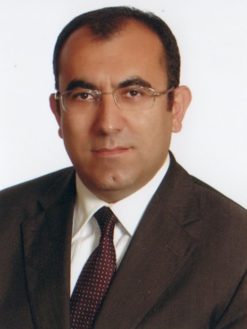
Academic Staff
Prof.Dr. Hacı Mehmet ŞAHİN
E-mail: mehmetsahin@karabuk.edu.tr
Phone:+90 3704187100 / 1413
Address: Karabuk / Turkey
Research Interests
Thermal Power Systems, Renewable Energy Systems, Concentrated Solar Powers, Computational Fluid Dynamics, Neutron Transport Theory and Simulation, Nuclear Radiation Shielding, Fusion-Fission (Hybrid) Reactors
Recent Academic Studies
Sümer Şahin, Hacı Mehmet Şahin, Comprehensive Energy Systems, 1.20 Nuclear Energy, Vol. 1, Pages 795-849, (Editor: İbrahim Dinçer), Elsevier, 2018.
S Şahi̇n, HM Şahin, G Tunç, Monte Carlo analysis of LWR spent fuel transmutation in a fusion-fission hybrid reactor system, Nuclear Engineering and Technology, Vol. 50 (8), pp 1339-1348, 2018.

Slide 64
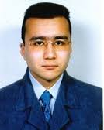
Academic Staff
Assoc.Prof.Dr. MUSTAFA BARIŞ TERCAN
E-mail: mtercan@karabuk.edu.tr
Phone:+90 370 418 71 00 / 1289
Address: Karabuk / Turkey
Research Interests
Solar Cells, Electronics, crystallography
Recent Academic Studies

Slide 65
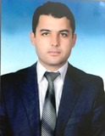
Academic Staff
Assoc.Prof.Dr. MUHAMMET KAYFECİ
E-mail: mkayfeci@karabuk.edu.tr
Phone:+90 370 418 71 00 / 1127
Address: Karabuk / Turkey
Research Interests
Fuel Cells, Heat Transfer, Insulation Technologies.
Recent Academic Studies
Ü. Elmas, F. BEDİR, and M. KAYFECİ, “Computational analysis of hydrogen storage capacity using process parameters for three different metal hydride materials,”International Journal of hydrogen energy, pp. 1–14, Dec. 2017.

Slide 66
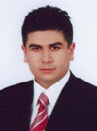
Academic Staff
Assoc.Prof.Dr. ENGİN GEDİK
E-mail: egedik@karabuk.edu.tr
Phone:+90 370 418 71 00 / 1109
Address: Karabuk / Turkey
Research Interests
Nanofluids, Computational Fluid Dynamics, Heat Pipe
Recent Academic Studies
E. GEDİK, “Experimental and Numerical Investigation on Laminar Pipe Flow of Magneto-Rheological Fluids under Applied External Magnetic Field,” Journal of Applied Fluid Mechanics, vol. 10, no. 3, pp. 801–811, 2017.

Slide 67

Academic Staff
Assist.Prof.Dr. BAHADIR ACAR
E-mail: bacar@karabuk.edu.tr
Phone:+90 370 418 71 00 / 1111
Address: Karabuk / Turkey
Research Interests
Solar Energy, Freeze drying.
Recent Academic Studies
A. ERGÜN, İ. CEYLAN, B. ACAR, and H. ERKAYMAZ, “Energy–exergy–ANN analyses of solar-assisted fluidized bed dryer,” Drying Technology, vol. 35, no. 14, pp. 1711–1720, Dec. 2017.

Slide 68
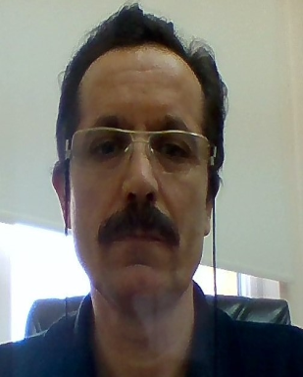
Academic Staff
Assist.Prof.Dr. METİN KAYA
E-mail: mkaya@karabuk.edu.tr
Phone:+90 370 418 71 00
Address: Karabuk / Turkey
Research Interests
Alternative Heating and Cooling Systems, Natural gas systems, Sanitary Systems.
Recent Academic Studies

Slide 69
Academic Staff
Assist.Prof.Dr. ŞAFAK ATAŞ
E-mail: satas@karabuk.edu.tr
Phone:+90 370 418 71 00/1045
Address: Karabuk / Turkey
Research Interests
HVAC, Cooling Systems, Heat pump
Recent Academic Studies
Ş. ATAŞ, M. AKTAŞ, İ. CEYLAN, and H. DOĞAN, “Development and Analysis of a Multi-evaporator Cooling System with Electronic Expansion Valves,” Arabian Journal for Science and Engineering, pp. 1–9, Apr. 2017.

Slide 70
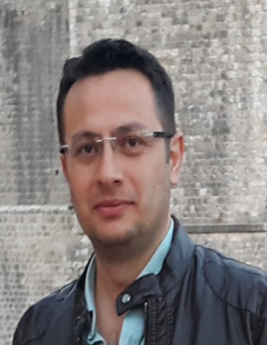
Academic Staff
Assist.Prof.Dr. ALPER ERGÜN
E-mail: alperergun@karabuk.edu.tr
Phone:+90 370 418 71 00/1098
Address: Karabuk / Turkey
Research Interests
Energy efficiency and Exergy, Thermodynamics,Organic Rankine Cycle, Photovoltaic Thermal Systems
Recent Academic Studies
Ergün A., Eyinç H., "Performance assessment of novel photovoltaic thermal system using nanoparticle in phase change material", International Journal Of Numerical Methods For Heat & Fluid Flow, vol.29, pp.1490-1505, 2019
Ceylan İ., Yilmaz S., İnanç Ö., Ergün A., Gürel A.E., Acar B., et al., "Determination of the heat transfer coefficient of PV panels", ENERGY, vol.175, pp.978-985, 2019
Zuhur S., Ceylan İ., Ergün A., "Energy, exergy and environmental impact analysis of concentrated PV/cooling system in Turkey", Solar Energy, vol.180, pp.567-574, 2019.

Slide 71
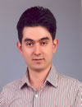
Academic Staff
Assist.Prof.Dr. SELÇUK SELİMLİ
E-mail: selcukselimli@karabuk.edu.tr
Phone:+90 370 418 71 00/1338
Address: Karabuk / Turkey
Research Interests
Thermodynamics,Heat Transfer,Fluid Mechanics,
Recent Academic Studies
S. SELİMLİ, Z. RECEBLİ, and S. Ülker, “SOLAR VACUUM TUBE INTEGRATED SEAWATER DISTILLATION AN EXPERIMENTAL STUDY,” Facta Universitatis, series: Mechanical Engineering (FU Mech Eng), vol. 14, no. 1, pp. 113–120, Apr. 2016.

Slide 72
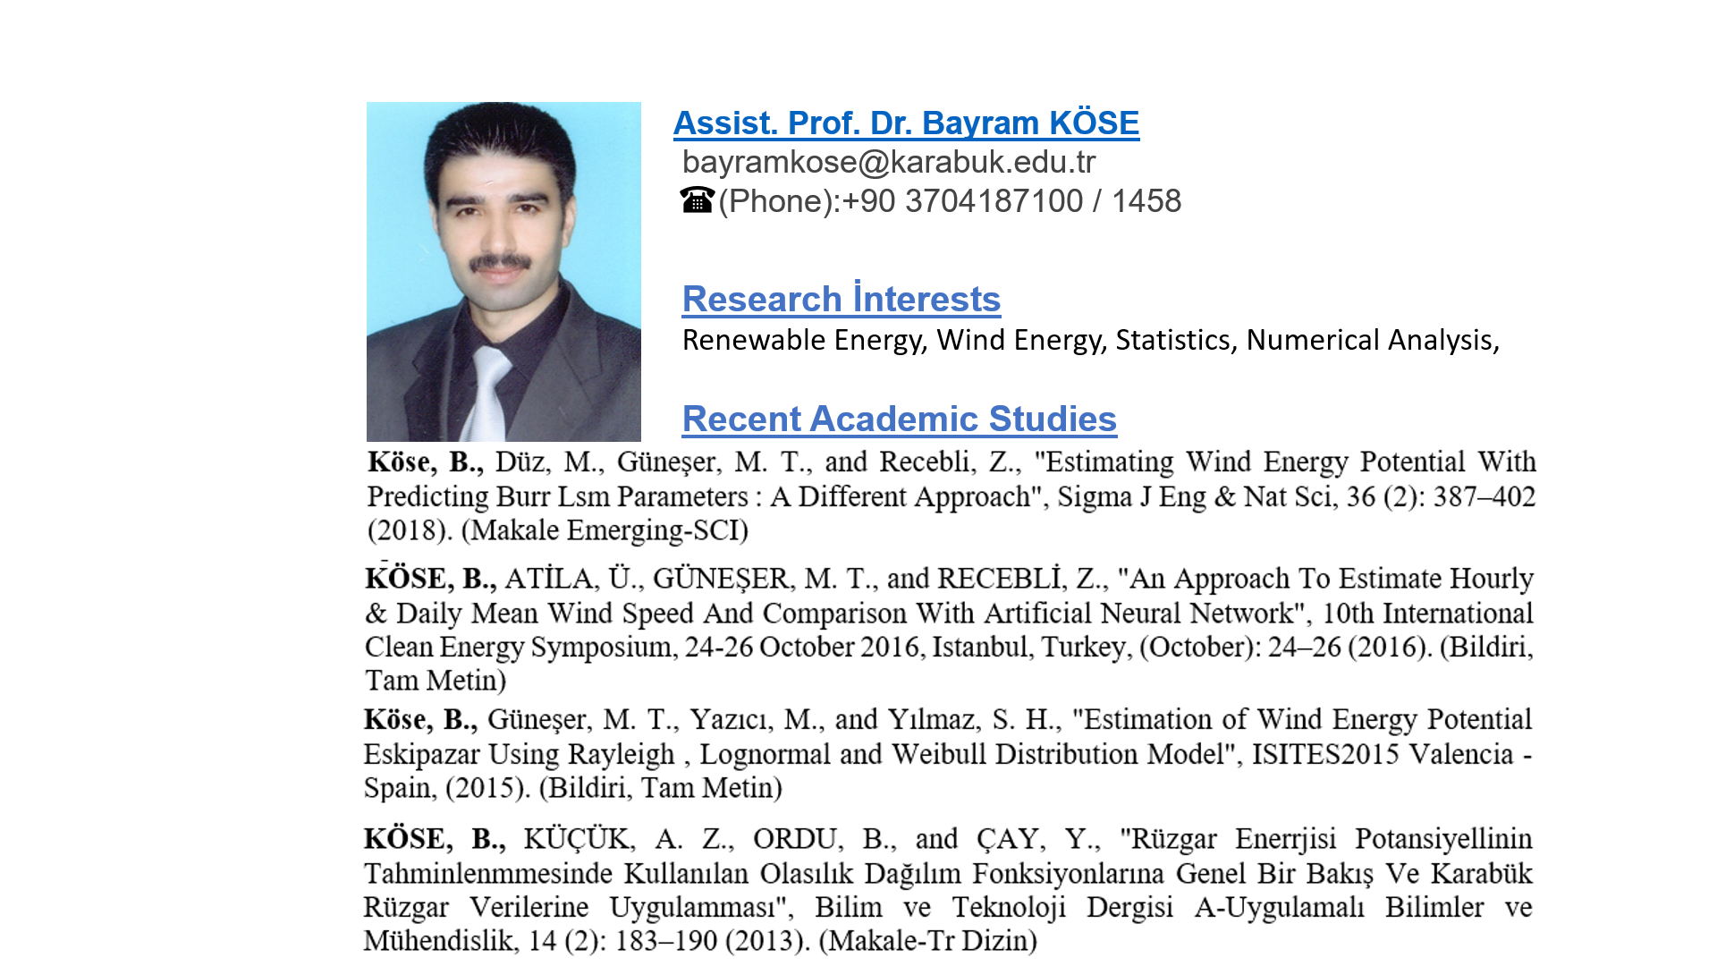
Academic Staff

Slide 73
Academic Staff
Research Assistants
Res. Assist. Özgür İNANÇ
Res. Assist. Ahmet CANAN
Res. Assist. Yakup DAŞDEMİRLİ
Res. Assist. Hakan DUMRUL
Res. Assist. Edip TAŞKESEN
Res. Asist. Abdullah DAĞDEVİREN

Slide 74
Energy Systems Engineering
Laboratories
Fluid Mechanics lab.
Heat lab.
HVAC Lab.
Mechanic lab.

Slide 75
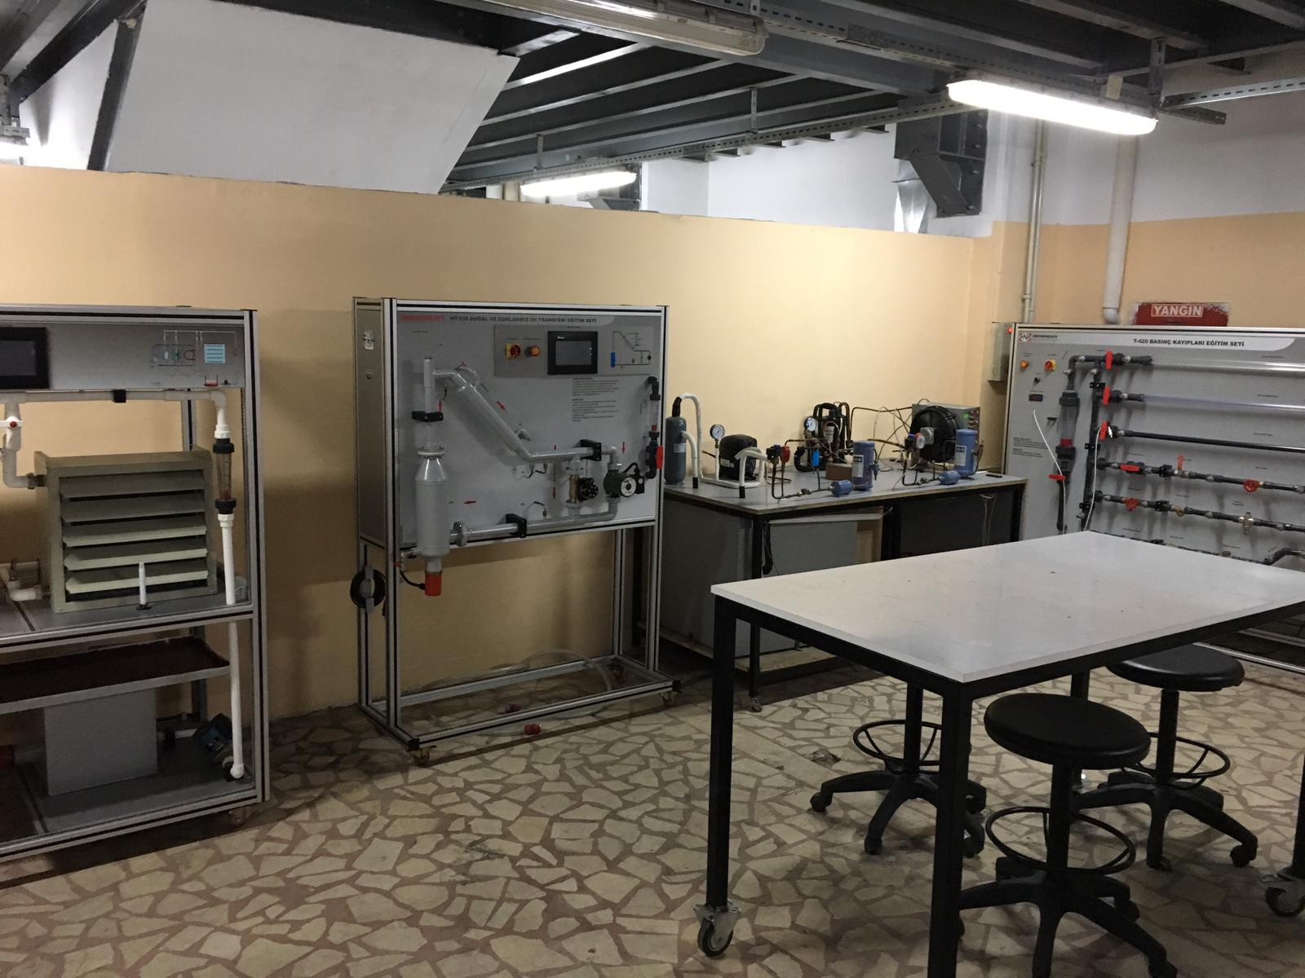
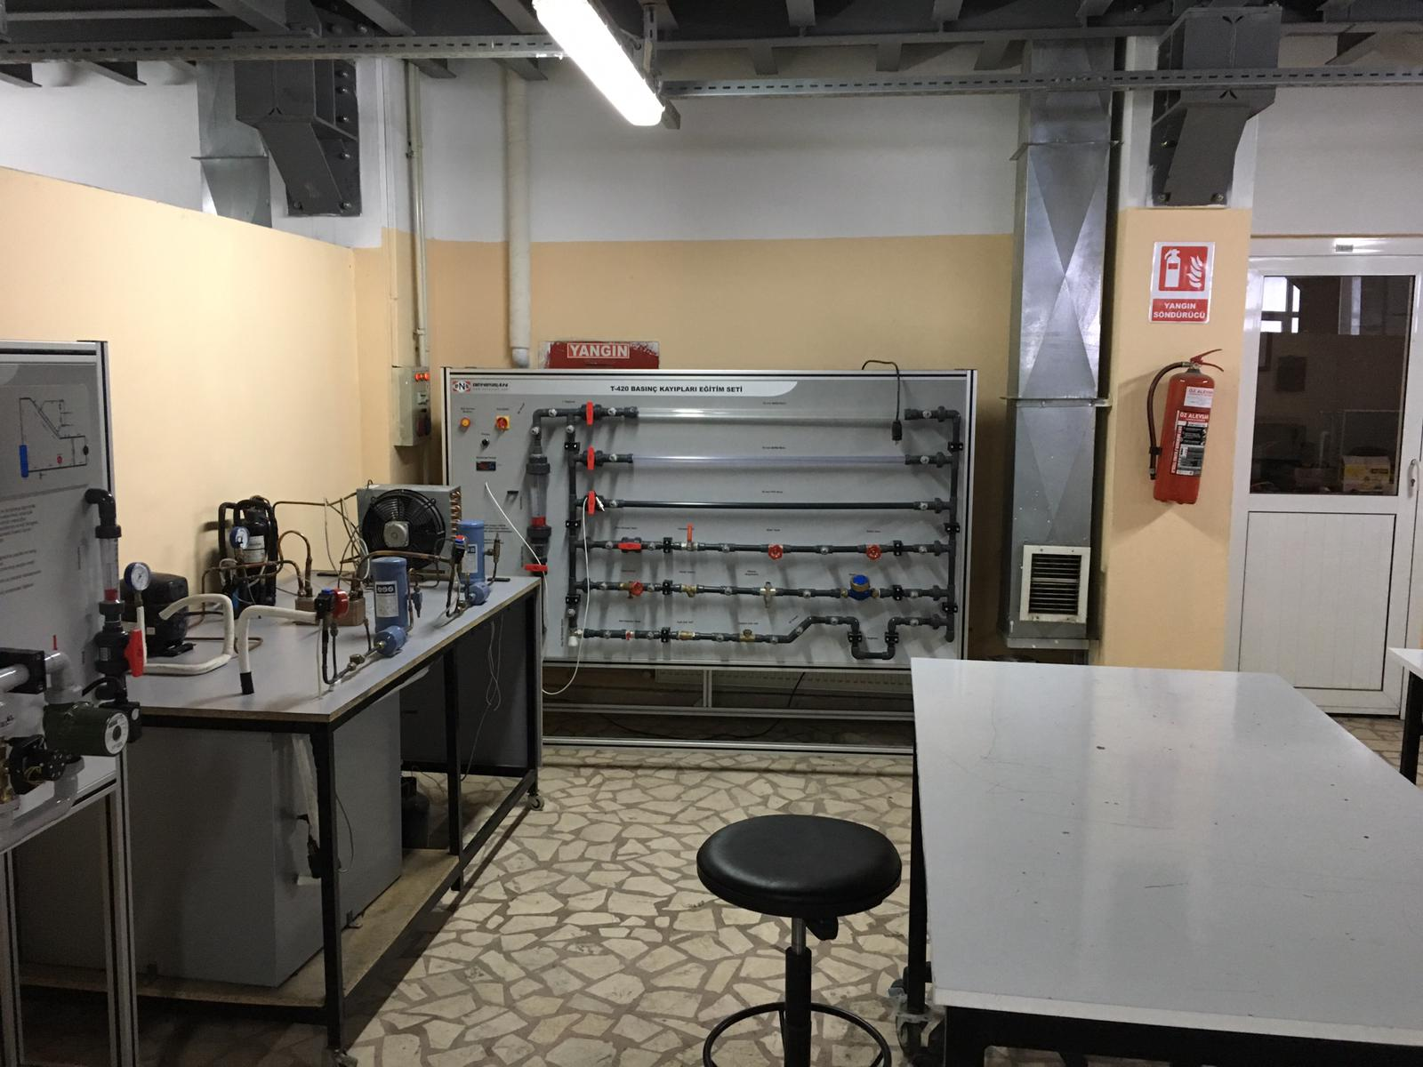
Energy Systems Engineering
Fluid Mechanics lab.

Slide 76
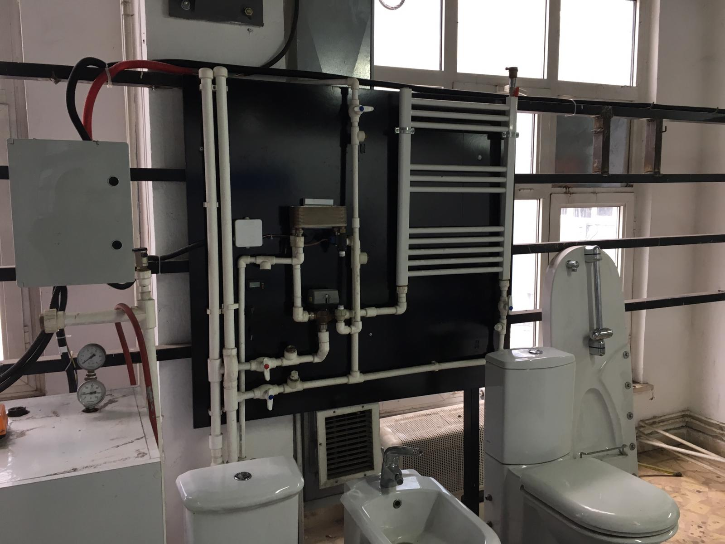
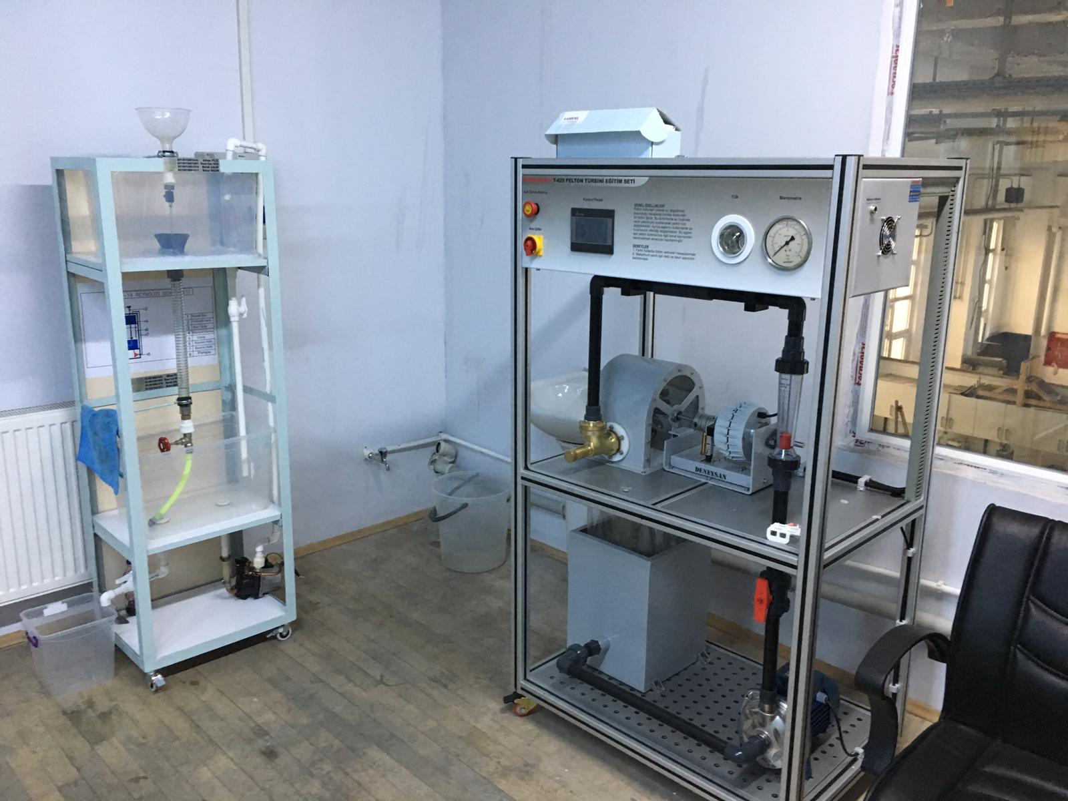
Energy Systems Engineering
Heat Lab.

Slide 77


Energy Systems Engineering
HVAC Lab.

Slide 78

Energy Systems Engineering
Mechanic Lab.

Slide 79
Projects
Determination of Optimum Operating Conditions for Biogas Production by Anaerobic Coffermantation Method of Different Tumble Wastes. KBÜ-BAP-16/2-DR-082
Condensed Photovoltaıc Panel Desıgn, Manufacturıng And Experımental Analysıs. KBÜBAP-17-DR-199
Design and Analysis of Solar Energetic Air Collecting and with PV / T Collector Supported Solar Energized Air Collector Drying Systems. KBÜBAP-17-YL-245
Experimental and theoretical investigation of nano fluid hybrid PV / T system. KBÜBAP-17-DR-262
Experimental investigation of hydrogen storage in multi-walled carbon nanotubes with various nanoparticles. KBÜ-BAP-16/1-DR-081
Numerical Investigation of Laminer Flow and Forced Heat Transport of Nanoparticles in Sudden Expansion Channels with Calculated Fluid Dynamics. KBÜ-BAP-16/1-YL-101

Slide 80

Awards
Name of the competition: Air Conditioning Industry Product and Engineering Design, 2017.
Name of the project: Solar Collector with condensing heat storage Award : 2nd - 15.000 TL
Prof.Dr. İlhan CEYLAN
M. Tolunay GÖKER,
Atakan YENİLİKÇİ,
Naim ÖZETÇİ,
Halit Akın ÖRS,
Selim ADAKUL.

Slide 81
Employment Fields
Energy systems engineers pursue a variety of jobs and occupations.
Design of HVAC systems
Solar and Wind energy plants,
Hydrogen energy,
Nuclear energy,
Energy Efficiency and Management,
Thermal plants,
New generation renewable energy systems.

Slide 82
Energy Systems Engineering
Contact Information
Postal address: Balıklarkayası Mevkii, Demir Çelik Kampüsü, Teknoloji Fakültesi 78050 Karabük/Türkiye
Department web page:
http://teknoloji.karabuk.edu.tr/enerjisistemleri-en
E-mail: teknolojifakultesi@karabuk.edu.tr

Slide 83

DEPARTMENT OF INDUSTRIAL DESIGN ENGINEERING

Slide 84
Industrial Design Engineering
History
Industrial design engineering program has accepted students for undergraduate degree since 2012-2013 fall semester.
It fills a great gap in meeting the requirement of Creative, Innovative Industrial Design Engineers who follow quality and up-to-date design/application technologies of national industry.

Slide 85
Industrial Design Engineering
Mission
To educate engineers who can apply the theoretical design skills to the engineering problems, to use software in design applications, to produce industrial solutions, to be a team leader, to have high self-confidence, to take responsibility.
Notes:
İpucu: Konuşmacı notlarınızı buraya ekleyin.

Slide 86
Industrial Design Engineering
Vision
To provide a industrial design engineering education that meets the highest global standards
To be innovative, pioneering and leading in education, research and service
To have faculty members, staff and students who seek perfection through collaborative, high quality and meaningful productivity.

Slide 87
About Industrial Design Engineering
Industrial Design Engineering is a discipline of engineering dealing with various design and analysis applications, research and development of products and systems.

Slide 88
About Industrial Design Engineering
Specialised Research Areas
Industrial Product Design
Metal Forming and Applications
Plastic Molds Design and Applications
Rapid Prototyping and 3D Printers
Polymer Composites
Furniture Design
CAD/CAM/CAE Applications
CNC System Design

Slide 89
Industrial Design Engineering
Course Credits (ECTS)
Elective courses: 58
  Technical elective courses: 42
  Social elective courses: 16
Fundamental courses: 36
Engineering courses: 88
Field courses: 133
Total credits: 240
Credits of theoretical courses: 112
Credits of practical courses: 128

Slide 90
Industrial Design Engineering
Double Major Programs
  Technology Faculty Energy Systems Engineering
  Technology Faculty Mechatronics Engineering
  Technology Faculty Manufacturing Engineering
  Engineering Faculty Mechanical Engineering
  Enginnering Faculty Industrial Engineering

Slide 91
Industrial Design Engineering
Graduate Programs
Master’s and Ph.D Degree
  EnIndustrial Design Engineering

Slide 92
Industrial Design Engineering
Faculty Members
Number of Professor : 2
Number of Associate Professor: 1
Number of Assistant Professor: 4
Number of Teaching Assistant: 2

Slide 93



Administrative Staff
Assoc. Prof. Dr. Suat ALTUN
Head of Department
Assist.Prof.Dr. Hatice AKGÜL EVLEN
Vice Head of Department
Assist.Prof.Dr. Musa YILDIRIM
Vice Head of Department

Slide 94

Academic Staff
Prof.Dr. İbrahim KADI
E-mail: ibrahimkadi@karabuk.edu.tr
Phone: +90(370)4187100 / 1066
Address: Karabuk University Technology Faculty Industrial Design Engineering Department Balıklarkayası Mevkii
78050 Merkez/Karabuk/TURKEY
Research Interests
Machine Design. Computer Aided Design. Metal Forming.
Recent Academic Studies
Mustafa YAŞAR, İbrahim KADI, ‘High velocity forming of aluminum cylindrical cups-experiments and numerical simulations’, Journal of Materials Science & Technology, Vol.23, No.2, 2007.
Mustafa YAŞAR, İbrahim KADI, ‘Bir saf detonasyon motorunun su içerisindeki tepkisinin deneysel olarak incelenmesi’, Journal of Faculty Engineering Arch. Gazi Üniv., Vol.21, No.3, 2006.
Elmas AŞKAR, İbrahim KADI, Mustafa YAŞAR, ‘Small diameter hydrostatic forming of AL5754 and AL1050 sheets’, Technology, Vol.13, No.1, 2010.

Slide 95

Academic Staff
Prof.Dr. Mustafa YAŞAR
E-mail: myasar@karabuk.edu.tr
Phone: +90(370)4187100 / 1009
Address: Karabuk University Technology Faculty Industrial Design Engineering Department Balıklarkayası Mevkii
78050 Merkez/Karabuk/TURKEY
Research Interests
Computer Aided Design. Metal Forming. Finite Element Analysis. Powder Metallurgy.
Recent Academic Studies
Şükrü şen, M. YAŞAR, and O. KOÇAR, “Dorse Tasarımında Stres Dağılım Analizi ve Topoloji Optimizasyonu,” Karaelmas Science and Engineering Journal, vol. 8, no. 1, pp. 309–316, Jun. 2018.
uğur bozali, M. YAŞAR, M. ÇETİN, V. V. ÇAY, and A. GÜNEN, “Investigation on wear mechanisms of boronized AISI 4150 steel,” Journal of Balkan Tribological Association, vol. 23, no. 1, pp. 1–15, Jan. 2017.
Ş. BÜLBÜL, N. AKÇAKALE, H. GÖKMEŞE, O. GÖK, and M. YAŞAR, “The effect on hardness and density of filling materials in NR SBR rubber compounds,” INTERNATIONAL ADVANCED RESEARCHES and ENGINEERING JOURNAL, vol. 1, no. 1, pp. 1–4, Dec. 2017.

Slide 96
Academic Staff
Assoc.Prof.Dr. Suat ALTUN
E-mail: saltun@karabuk.edu.tr
Phone: +90(370)4187100 / 1063
Address: Karabuk University Technology Faculty Industrial Design Engineering Department Balıklarkayası Mevkii
78050 Merkez/Karabuk/TURKEY
Research Interests
Furniture Design. Wood and Wood-Based Materials and Composites.
Recent Academic Studies
A. ÖZÇİFÇİ, E. S. KÖKTEN, N. AYRILMIŞ, G. ÖZBAY, and S. ALTUN, “Effects of catalysts on modulus of rupture and chemical structure of heat treated wood,” Drvna Industrija, vol. 69, no. 3, pp. 207–213, Oct. 2018.
Suat ALTUN, Veysel TOKDEMİR, ‘Modification with melamine formaldehyde and melamine-urea formaldehyde resin to improve the physical and mechanical properties of wood’, BioResources, Vol.12, No.1, 2017.
Suat ALTUN, Oğuzhan YÜKSEL, ‘Use of after sales service data in production management: A case study in a furniture firm’, 2nd International Furniture Congress, 2016.

Slide 97
Academic Staff
Assist.Prof.Dr. Hatice AKGÜL EVLEN
E-mail: hakgul@karabuk.edu.tr
Phone: +90(370)4187100 / 1092
Address: Karabuk University Technology Faculty Industrial Design Engineering Department Balıklarkayası Mevkii
78050 Merkez/Karabuk/TURKEY
Research Interests
Computer Aided Design. Metal Forming. 3D Printers. Bio-Materials. Composites.
Recent Academic Studies
H. EVLEN, A. Çalışkan, and N. DEMİRKOL, “Production and characterization of ceramic materials in three dimensional printer,” Arabian Journal of Geosciences, vol. 11, no. 16, pp. 1–6, Aug. 2018.
H. EVLEN, gülçin erel, and elif yılmaz, “3 Boyutlu Yazıcı Tasarımı Ve Yazdırma Doluluk Oranının Mekanik Özellikler Üzerine Etkisinin İncelenmesi,” International Journal of 3D Printing and Digital Industry, vol. 2, no. 1, pp. 23–31, Jan. 2018.
H. EVLEN, gülçin erel, and elif yılmaz, “Açık Ve Kapalı Sistem Tasarımının 3B Yazıcılarda Parça Mukavemetine Etkisinin İncelenmesi,” Politeknik Dergisi, pp. 0–0, 2018.

Slide 98

Academic Staff
Assist.Prof.Dr. Özkan ÖZ
E-mail: ooz@karabuk.edu.tr
Phone: +90(370)4187100 / 1094
Address: Karabuk University Technology Faculty Industrial Design Engineering Department Balıklarkayası Mevkii
78050 Merkez/Karabuk/TURKEY
Research Interests
Mechanics. Strength of Materials. Adhesives. Finite Element Method. Polymer Composites.
Recent Academic Studies
M. AYDIN and Ö. ÖZ, “APPLICATION OF DIGITAL IMAGE CORRELATION TECHNIQUE TO TENSILE TEST FOR PRINTED PLA SPECIMENS,” International Journal of 3D Printing Technologies and Digital Industry, vol. 2, no. 2, pp. 1–7, Jul. 2018.
Ö. ÖZ, M. AYDIN, A. S. KARA, and M. S. SANCAK, “ÜÇ BOYUTLU YAZICILARDA KULLANILAN DOLULUK ORANININ HASAR YÜKÜNE OLAN ETKİSİNİN BELİRLENMESİ,” International Journal of 3D Printing Technologies and Digital Industry, vol. 2, no. 1, pp. 32–39, Mar. 2018.

Slide 99

Academic Staff
Assist.Prof.Dr. Musa YILDIRIM
E-mail: musayildirim@karabuk.edu.tr
Phone: +90(370)4187100 / 1116
Address: Karabuk University Technology Faculty Industrial Design Engineering Department Balıklarkayası Mevkii
78050 Merkez/Karabuk/TURKEY
Research Interests
Powder Metallurgy. Metal-Based Composite Materials. Casting Technology.
Recent Academic Studies
M. YILDIRIM and D. ÖZYÜREK, “An Investigation of Wear Behaviors of AA7075 Al Hybrid Composites,” High Temperature Materials and Processes, vol. 37, no. 7, pp. 619–624, Jul. 2018.
İ. ŞİMŞEK, M. YILDIRIM, D. ÖZYÜREK, T. TUNÇAY, and D. ŞİMŞEK, “MEKANİK ALAŞIMLAMA ÖĞÜTME YÖNTEMİ İLE ÜRETİLEN Al SiC KOMPOZİTLERİNİNCELENMESİ,” Technological Applied Sciences, pp. 0–0, Apr. 2018.
İ. ŞİMŞEK, M. YILDIRIM, D. ÖZYÜREK, and T. TUNÇAY, “AA7075 ALAŞIMININ T6 ISIL İŞLEMİNDE YAŞLANDIRMA SÜRESİNİN AŞINMA DAVRANIŞI ÜZERİNE ETKİSİ,” İleri Teknoloji Bilimleri Dergisi, vol. 7, no. 1, pp. 42–49, 2018.

Slide 100

Academic Staff
Assist.Prof.Dr. Murat AYDIN
E-mail: murataydin@karabuk.edu.tr
Phone: +90(370)4187100 / 1014
Address: Karabuk University Technology Faculty Industrial Design Engineering Department Balıklarkayası Mevkii
78050 Merkez/Karabuk/TURKEY
Research Interests
Metal Forming. Finite Element Analysis. Digital Image Correlation. 3D Printers.
Recent Academic Studies
M. AYDIN and Ö. ÖZ, “APPLICATION OF DIGITAL IMAGE CORRELATION TECHNIQUE TO TENSILE TEST FOR PRINTED PLA SPECIMENS,” International Journal of 3D Printing Technologies and Digital Industry, vol. 2, no. 2, pp. 1–7, Jul. 2018.
Ö. ÖZ, M. AYDIN, A. S. KARA, and M. S. SANCAK, “ÜÇ BOYUTLU YAZICILARDA KULLANILAN DOLULUK ORANININ HASAR YÜKÜNE OLAN ETKİSİNİN BELİRLENMESİ,” International Journal of 3D Printing Technologies and Digital Industry, vol. 2, no. 1, pp. 32–39, Mar. 2018.
M. AYDIN, X. WU, K. ÇETİNKAYA, İ. KADI, and M. YAŞAR, “Application of Digital Image Correlation in Uniaxial Tensile Test,” European Journal of Engineering and Natural Sciences, vol. 1, no. 1, pp. 23–32, Jan. 2016.

Slide 101

Academic Staff
Res.Assist. Abdurrahim TEMİZ
E-mail: abdurrahimtemiz@karabuk.edu.tr
Phone: +90(370)4187100 / 1020
Address: Karabuk University Technology Faculty Industrial Design Engineering Department Balıklarkayası Mevkii
78050 Merkez/Karabuk/TURKEY
Research Interests
Metal Foam. Heat Transfer. Finite Element Analysis. 3D Printers.
Recent Academic Studies
Abdurrahim TEMİZ, Koray ÖZDEMİR, M. Sait Cay, Levent TURHAN, Mustafa YAŞAR “ALTIGEN BAL PETEĞİ METAL KÖPÜK KANATLARA SAHİP KOMPAKT ISI DEĞİŞTİRİCİ TEORİK ANALİZİ”, 14th International Combustion Symposium (INCOS2018), 163-168.
A. Temiz and K. ÇETİNKAYA, “DEVELOPMENT OF STRATEGIC CHANGES WITH DIGITAL INDUSTRY,” presented at the VIII International Scientific and Practical Conference “Strategic Priorities of the Socio-Economic Development in Terms of Institutional Transformations of the Global Environment” , 2018.

Slide 102

Academic Staff
Res.Assist. Fatih Huzeyfe ÖZTÜRK
E-mail: fhozturk@karabuk.edu.tr
Phone: +90(370)4187100 / 1020
Address: Karabuk University Technology Faculty Industrial Design Engineering Department Balıklarkayası Mevkii
78050 Merkez/Karabuk/TURKEY
Research Interests
Adhesives.Finite Element Analysis. Mechanics
Recent Academic Studies
F. H. ÖZTÜRK, Ö. ÖZ, and K. ÇETİNKAYA, “THREE DIMENSIONAL POWDER AND GRANULA MIXER PROTOTYPE AND MANUFACTURİNG,” presented at the 3rd International Congress on 3D Printing (Additive Manufacturing)Technologies and Digital Industry 2018, Antalya, 2018.
Ç. CEBECİ, M. AYDIN, F. H. ÖZTÜRK, U. CAH, and H. EVLEN, “3B KOMPRESÖRLÜ SERAMİK YAZICI TASARIMI VE PROTOTİP ÜRETİMİ,” presented at the 2nd INTERNATIONAL SYMPOSIUM ON 3D PRINTING TECHNOLOGIES , 2017.

Slide 103
Industrial Design Engineering
Laboratories
Basic Operations Lab.
Polymer Development Lab.
Product Development Lab.
3D Printer Lab.
Measuring Lab.
CAD/CAM Lab.

Slide 104



Industrial Design Engineering
Basic Operations Lab.

Slide 105

Industrial Design Engineering
Polymer Development Lab.

Slide 106



Industrial Design Engineering
Product Development Lab.

Slide 107



Industrial Design Engineering
3D Printer Lab.

Slide 108

Industrial Design Engineering
Measuring Lab.

Slide 109

Industrial Design Engineering
CAD/CAM Lab.

Slide 110
Projects
Design and Production of Metal Foam
Design of Seramic 3D Printer
Design and Prototype of Bio 3D Printer
Production of Carbon Reinforced 3D Printer Filament
Design and Prototype of Laser 3D Printer
Wood Reinforced Filament Production
Digital Image Correlation Applications
Hot Metal Forming Applications

Slide 111
Industrial Design Engineering
Contact Information
Postal address:
Karabuk University, Faculty of Technology,
Industrial Design Engineering Department,
Demir Çelik Kampüsü 78050 KARABÜK
Department web page:
http://teknoloji.karabuk.edu.tr/endustriyeltasarim-en
E-mail: teknolojifakultesi@karabuk.edu.tr

Slide 112

DEPARTMENT OF MECHATRONICS ENGINEERING

Slide 113
Mechatronics Engineering
History
Mechatronics Engineering Department is the most intense academic program in Karabuk University. Mechatronics Engineering Department was opened in 2010. Fields of study in this department are mechatronics, machine, computer software and hardware, control systems, electrical, electronics and robotics.

Slide 114
Mechatronics Engineering
Mission
Mechatronics Engineering is a discipline which is composed of Mechanical Engineering, Electric-Electronics Engineering, and Computer Engineering for solving the sensitive and intelligent product designing problems. Our mission is educating engineers who have application experience, and the ability, determining the problems of Mechatronics Engineering, formulation, modeling, analyzing, and the same time who embrace the modern universal ethos and believe the superiority of law.
Notes:
İpucu: Konuşmacı notlarınızı buraya ekleyin.

Slide 115
Mechatronics Engineering
Vision
Our vision is to educate with the same universal standards as international and national schools that has; strong possibilities, international quality standards, education application standards, strong relations with industry and to make a success of advanced researches, applications and scientific articles via guidance of Europe (Erasmus-Socrates), USA (ABET), and competence engineering principles (MUDEK) for science and technology.
Notes:
İpucu: Konuşmacı notlarınızı buraya ekleyin.

Slide 116

About Mechatronics Engineering
Mechatronics engineering is a new multidisciplinary engineering field which combines machine, electrics-electronics and computer science.
Mechatronics engineering is applied for sensitive and smart product designing or request and problem solving

Slide 117
About Mechatronics Engineering
Specialised Research Areas
Electric Vehicles
Robotic
Autonomous Air Vehicles
Semiconductor Technologies
Optimization Techniques
Motor Control Technologies
Battery Management Systems
Embedded Systems

Slide 118
Mechatronics Engineering
Course Credits (ECTS)
Elective courses: 49
Fundamental courses: 12
Engineering courses: 53
Field courses: 126
Total Credits: 240
Credits of theoretical courses: 135
Credits of practical courses: 105

Slide 119
Mechatronics Engineering
Double Major Programs
Manufacturing Engineering
Industrial Design Engineering
Energy Systems Engineering
Medical Engineering
Mechanical Engineering

Slide 120
Mechatronics Engineering
Graduate Programs
Master’s and Ph.D Degree
  Mechatronics Engineering

Slide 121
Mechatronics Engineering
Department Members
Number of Professor: 2
Number of Associate Professor: 1
Number of Assistant Professor: 2
Number of Research Assistant: 3

Slide 122


Administrative Staff
Prof. Dr. Raif BAYIR
Head of Department
Prof. Dr. Mustafa ANUTGAN
Vice Head of Department
Name and Surname
Vice Head of Department

Slide 123
Academic Staff
Prof. Dr. Raif BAYIR
E-mail: rbayir@karabuk.edu.tr
Phone: +90 370 418 71 00 / 1218
Address: Karabuk University, Faculty of Technology,
Department of Mechatronics Eng. Demir Çelik Campus,
78050, Karabük
Research Interests
Artificial Intelligence, Fuzzy Logic, Robotics, Electric Vehicles and Their Technology, Unmanned Air and Ground Vehicles, Fault Detection and Diagnosis in Electric Machines, Wireless Sensor Networks
Recent Academic Studies
1. Albayrak A., Duran, F., Bayır R., Albayrak A., “Development of Intelligent Decision Support System Using Fuzzy Cognitive Maps for Mobile Beekeepers” Turkish J.of Electrical Engineering & Computer Sciences, (Baskıda) 2017.
2. Soylu E., Soylu T., Bayır, R. “Design and Implementation of SOC Prediction for a Li-Ion Battery Pack in an Electric Car with an Embedded System”, Entropy 19 (4), 146, 2017.
3. Demir B E., Bayır R., Duran F. “Real-time trajectory tracking of an unmanned aerial vehicle using a self-tuning fuzzy proportional integral derivative controller”, International Journal of Micro Air Vehicles, 8 (4), 252-268, 2016.
4. Çeven, S., Bayır, R. “Implementation of Fuzzy Logic Based Speed Control Of Brushless Direct Current Motors Via Industrial PC”, Int. Conference on Advanced Technology & Sciences (ICAT’16), Türkiye Konya, Eylül 1-3, 2016.

Slide 124
Academic Staff
Prof. Dr. Mustafa ANUTGAN
E-mail: mustafaanutgan@karabuk.edu.tr
Phone: +90 370 418 71 00 / 1026
Address: Karabuk University, Faculty of Technology,
Department of Mechatronics Eng. Demir Çelik Campus,
78050, Karabük
Research Interests
Technology of Semiconductor Device, Energy Harvesting with Piezoelectricity, Optical Diagnosis of Blood Sugar, Applied Mathematics
Recent Academic Studies
1. Anutgan, T., Anutgan, M., Atilgan, I., & Katircioglu, B. (2017). Electroformed silicon nitride based light emitting memory device. Applied Physics Letters, 111(5), 053502.
2. Amirov Sh., Anutgan M. (2017). Analytical solitary wave solutions for the nonlinear analogues of the Boussinesq and sixth-order modified Boussinesq equations. Journal of Applied Analysis and Computation, 7(4), 1613-1623.
3. Mustafa ANUTGAN, Tamila ANUTGAN, İsmail ATILGAN, Temporary Sub-band Transport Level in Nanocrystalline Silicon Nitride Light Emitting Memory Device, 27th International Conference on Amorphous and Nanocrystalline Semiconductors (ICANS27), 21-25 August 2017, Seoul National University, Seoul, Korea, p. 104.
4. Tamila ANUTGAN, Mustafa ANUTGAN, İsmail ATILGAN, Two-stage Instability Mechanism in Nanocrystalline Silicon TFTs Under Prolonged Gate-bias Stress, 27th International Conference on Amorphous and Nanocrystalline Semiconductors (ICANS27), 21-25 August 2017, Seoul National University, Seoul, Korea, p. 48-49.

Slide 125

Academic Staff
Assist. Prof. Dr. Metin ZEYVELİ
E-mail: mzeyveli@karabuk.edu.tr
Phone: +90 370 418 71 00 / 1108
Address: Karabuk University, Faculty of Technology,
Department of Mechatronics Eng. Demir Çelik Campus,
78050, Karabük
Research Interests
Mechanics and Machine Elements, Machine Design, Manufacturing and Machinability, Mechanics Tests, Artificial Intelligence, Optimization, Genetic Algorithms, Clinching Rivet.
Recent Academic Studies
1. Zeyveli M., Karaoğlan K. M. (2015). İmalat Endüstrisinde Durum İzleme Sistemlerinin Geliştirilmesi ve Zeki Denetimli Kullanımı. Güç Aktarım ve Hareket Kontrol Dergisi, 5 (7), Temmuz 2015.
2. Zeyveli M., (2009). A Genetic Approach to Automate Preliminary Design of Gear Drives. Computers & Industrial Engineering, 57(3), 1043-1051, 2009 .
3. Zeyveli M., Sur G. (2017). Investigation of the Machinability of Vanadis 30 Powder Metallurgical Steel with Taguchi Method, The IRES International Conference, Lisbon, Portucal, 11-12 May 2017, pp35-38.
4. Karaoğlan K. M., Zeyveli M. (2016). Talaşlı İmalatta İş Mili Motorunun PID İle Hız Denetiminin Yüzey Pürüzlülüğüne Etkisi. 7th International Symposium On Machining, November 3-5, 2016, Marmara University, Istanbul.

Slide 126

Academic Staff
Assoc. Prof. Dr. Hüseyin TECİMER
E-mail: huseyintecimer@karabuk.edu.tr
Phone: +90 370 418 71 00 / 1167
Address: Karabuk University, Faculty of Technology,
Department of Mechatronics Eng. Demir Çelik Campus,
78050, Karabük
Research Interests
Physics, Electronics, Semiconductor Device, Survey of Electric-Dielectric Characteristics
Recent Academic Studies
1. H. Tecimer, Ş. Altındal, S. Aksu, Y. Atasoy, E. Bacaksız. Interpretation of barrier height inhomogeneities in Au/In2S3/ SnO2/(In-Ga) structures at low temperatures. J Mater Sci: Mater Electron (2017) 28:7501–7508
2. O. Çiçek , H. Uslu Tecimer, S.O. Tan, H. Tecimer, I. Orak, S. Altındal. Synthesis and characterization of pure and graphene (Gr)-doped organic/polymer nanocomposites to investigate the electrical and photoconductivity properties of Au/n-GaAs structures. Composites Part B 113 (2017) 14‒23
3. Özerden Enise, Kiliçoglu Tahsin, Turut Abdulmecit, Tecimer Hüseyin, Altindal Semsettin, Ocak Yusuf Selim, Tombak Ahmet (2015). Temperature and frequency effects on the electrical and dielectric properties of the Ag 9 10 H2BaP n Si Au Sb MIS Schottky structure. 1st International Conference on Organic Electronic Material Technologies (OEMT 2015) (Özet Bildiri/)(Yayın No:2362289)
4. Orak Ikram, Akin Buket, Tecimer Hüseyin, Uslu Habibe, Altindal Semsettin (2015). The Frequency Dependent Admittance Measurements of Au ZnO n GaAs Schottky Barrier Diodes SBDs. 1st International Conference on Organic Electronic Material Technologies (OEMT’2015) (Özet Bildiri/)(Yayin No:2362797)

Slide 127

Academic Staff
Assist. Prof. Dr. Mehmet ŞİMŞİR
E-mail: msimsir@karabuk.edu.tr
Phone: +90 370 418 71 00 / 1310
Address: Karabuk University, Faculty of Technology,
Department of Mechatronics Eng. Demir Çelik Campus,
78050, Karabük
Research Interests
Electric Machines, Artificial Intelligence, Fault Detection, Chaotic Systems, Power Optimization
Recent Academic Studies
1. Şimşir M., Bayır R., Uyaroğlu Y. (2016). Real-Time Fault Diagnosis of Hub Motors Using a Fuzzy Logic Controller. Electronics World, (3), 18-20.
2. Şimşir M., Bayır R., Uyaroğlu Y. (2016). Real-Time Monitoring and Fault Diagnosis of a Low Power Hub Motor Using Feedforward Neural Network. Computational Intelligence and Neuroscience (2016), 36.
3. Şimşir M., Tutkun N. (2009). Improved Core Geometry of a Low Power Modular Wind Generator Using The Real Coded Genetic Optimization Technique. IATS 2009, p.293-297.
4. Tutkun N., Şimşir M. (2007). Sinüzoidal Darbe Genişlik Modülasyonlu Gerilim Dalga Şeklinde Toplam Harmonik Distorsiyon Miktarının Genetik Optimizasyon Tekniği ile Azaltılması. Enerji Verimliliği ve Kalitesi Sempozyumu p.10-14.

Slide 128

Academic Staff
Assist. Prof. Dr. Batıkan Erdem DEMİR
E-mail :bedemir@karabuk.edu.tr
Phone :3704187100 / 1234
Address: Karabuk University, Faculty of Technology,
Department of Mechatronics Eng. Demir Çelik Campus,
78050, Karabük
Research Interests
Computer-assisted Control, Artificial intelligence, Unmanned Aerial Vehicles, Mathematical Modelling of Unmanned Vehicles, Autopilot and Guidance Design, System Identification, Robotics
Recent Academic Studies
B. E. Demir, R. Bayır, F. Duran, “Real-Time Trajectory Tracking of an Unmanned Aerial Vehicle Using a Self-Tuning Fuzzy PID Controller”, International Journal of Micro Air Vehicles, vol. (8) 4, pp. 252-268, 2016.
İ. Çayıroğlu and B. E. Demir, “Computer assisted glass mosaic tiling automation”, Robotics and Computer-Integrated Manufacturing, vol. (28) 5, pp. 583-591, 2012.
F. Demir, B. E. Demir, “Internet Controlled Electronic Scoreboard Desing”, 6th International Conference on Advanced Technology & Sciences (ICAT'Riga), 2017.
B. E. Demir, R. Bayır, “Modeling and Control of an Unmanned”, 4th International Conference on Advanced Technology & Sciences (ICAT'Rome), 2016.

Slide 129

Academic Staff
Res. Assist. Kadriye ÖZ
E-mail :kadriyeoz@karabuk.edu.tr
Phone :3704187100 / 1122
Address: Karabuk University, Faculty of Technology,
Department of Mechatronics Eng. Demir Çelik Campus,
78050, Karabük
Research Interests
Image Processing, Machine Learning, Parallel Programming
Recent Academic Studies
Öz, K. , GÖRGÜNOĞLU, S., 2016. Video Gözetim Sistemlerinde Anomali Tespiti Üzerine Bir Derleme. El-Cezeri Fen ve Mühendislik Dergisi, 3 (3), 0-0.
Görgünoğlu, S., Öz, K., Çavuşoğlu, A., 2016. CUDA Based Speed Optimization of the PCA Algorithm. TEM J. 5, 152–159. doi:10.18421/TEM52-05
Öz, K., Görgünoğlu, S., 2016. Anomaly Detection System With Optical Flow Method, in: 2nd International Conference on Science, Ecology and Technology-2016 (ICONSETE’2016). p. 490.
Öz, K., Karaş, İ. R., 2017. Anomaly Detection with Structural Similarity and Optical Flow Histogram. in:Akıllı Sistemlerde Yenilikler ve Uygulamalar (ASYU) Konferansı ASYU 2017, Alanya. p.53.

Slide 130

Academic Staff
Res. Assist. Mustafa Feyzi TEMEL
E-mail :feyzitemel@karabuk.edu.tr
Phone :3704187100 / 1035
Address: Karabuk University, Faculty of Technology,
Department of Mechatronics Eng. Demir Çelik Campus,
78050, Karabük
Research Interests
Artificial Intelligence, Deep Learning, Robotics, Electric Vehicles and Technologies

Slide 131

Academic Staff
Res. Assist. Semih PAK
E-mail :semihpak@karabuk.edu.tr
Phone :3704187100 / 1297
Address: Karabuk University, Faculty of Technology,
Department of Mechatronics Eng. Demir Çelik Campus,
78050, Karabük
Research Interests
Artificial Intelligence, Embedded Systems, Optimization

Slide 132
Mechatronics Engineering
Laboratories
Electrical-Electronics Laboratory
Technical Drawing Laboratory
Programmable Logic Controllers and Industrial Automation Laboratory
Motion Control Laboratory
Microprocessors and Microcontrollers Laboratory
Robotic Laboratory
Pneumatic-Electropneumatic Laboratory
Electric Machines Laboratory
Computer Laboratories
Robotic Welding Cell Laboratory

Slide 133

Mechatronics Engineering
Electrical-Electronics Laboratory

Slide 134

Mechatronics Engineering
Technical Drawing Laboratory

Slide 135

Mechatronics Engineering
Programmable Logic Controllers and Industrial Automation Laboratory

Slide 136

Mechatronics Engineering
Motion Control Laboratory

Slide 137

Mechatronics Engineering
Microprocessors and Microcontrollers Laboratory

Slide 138

Mechatronics Engineering
Robotic Laboratory

Slide 139

Mechatronics Engineering
Pneumatic-Electropneumatic Laboratory

Slide 140

Mechatronics Engineering
Electric Machines Laboratory

Slide 141

Mechatronics Engineering
Computer Laboratories

Slide 142

Mechatronics Engineering
Welding Laboratory-Robotic Welding Cell

Slide 143
Selected Department Projects
Project Partner, InFiRo Integrated Physics Approach to Robotics Designed Laboratory, Leonardo Da Vinci Transfer of innovation, 2011-1-HR1-LEO05-00828, Project Coordinator, 2011-2014, (Prof. Dr. Raif BAYIR).
Intelligent Controlled Electronic Differential Design and Implementation for Electric Vehicles, Karabük University Scientific Research Project, KBÜ-BAP-14/2-DS-046, Project Coordinator, 2016 – 2017. (Prof. Dr. Raif BAYIR).
Gülderen A., Anutgan M. Estimation of blood sugar using artificial neural networks,KBÜ-BAP-15/2-YL-014, 2015, (Assoc. Prof. Dr. Mustafa ANUTGAN).
Demir F., Anutgan M., Energy Harvesting by Piezoelectric Material, KBÜ-BAP-15/1-DR-004, 2017, (Assoc. Prof. Dr. Mustafa ANUTGAN).

Slide 144
Selected Department Projects
TCM based System for Spindle Motor Realtime Cycle Control in Cnc Workbench Karabük University Scientific Research Project, KBÜ-BAP- 13/2-YL-027, Project Coordinator, 2014 – 2016, (Assist. Prof. Dr. Metin ZEYVELİ).
Combining Magnesium and Aluminium Alloys which are Used in Automotive and Aviation Sectors with Unrivet Riveting Method and Examining Their Mechanical Behaviours Karabük University, Scientific Research Project, KBÜ-BAP-11/2-YL-018, Project Coordinator, 2012 – 2013, (Assist. Prof. Dr. Metin ZEYVELİ).

Slide 145
Selected Department Projects
Au Zn Compounded n GaAs Structures Preparation and Examining of Their Physical Features, Research Project, Researcher, 02/05/2012 - 01/05/2013 (National), (Assist. Prof. Dr. Hüseyin TECİMER).
Ferroelectric Bi₃Ti₄O₁₂ Interface Layer Structures Preparation and Examining of Their Electronic Parameters, Research Project, Researcher, 09/05/2011 - 01/10/2012 (National), (Assist. Prof. Dr. Hüseyin TECİMER).
Controller Design for a Six Legged Robot with FPGA, TUBITAK-1002, Researcher, 2015-2016, (Assist. Prof. Dr. Hüseyin Oktay ERKOL).
A VHDL Application for Kinematic Equation Solutions of Multi-degree-of-freedom Systems, Scientific Research Department of Karabuk University, KBÜ-BAP-13/1-DR-011, Researcher, 2013-2015, (Assist. Prof. Dr. Hüseyin Oktay ERKOL).

Slide 146
Selected Department Projects
Intelligent Controlled Electronic Differential Design and Implementation for Electric Vehicles, Karabük University, Scientific Research Project,KBÜ-BAP-14/2-DS-046, Project Researcher, 2017, (Res. Assist. Dr. Emel SOYLU).
Determining Optimal Charge and Discharge Conditions of Batteries with Artificial Intelligence and Condition Monitoring , Karabük University, Scientific Research Project, KBU-BAP-13/1-DR-005, Project Researcher, 2015, (Res. Assist. Dr. Emel SOYLU).
Detection of Road and Railroad Networks in Synthetic Aperture Radar Images by using Various Methods, Ankara Yıldırım Beyazıt Üniversity, Preliminary Scientific Research Project, Project Number:631, Researcher, 2014-2015, (Res. Assist. Dr. Şafak ALTAY AÇAR).

Slide 147
Awards
Electromobile Awards
2016 – Efficiency Challenge Electric Vehicle – Domestic Award
2015 – Efficiency Challenge Electric Vehicle – Domestic Award
2014 – Efficiency Challenge Electric Vehicle – The Best Design Award
Sumo Robot Awards
2016 – Fujisoft International Robot Sumo Tournament – Champion
2016 – Fujisoft International Robot Sumo Tournament – Runner up
2015 – Fujisoft International Robot Sumo Tournament – Champion
2014 – Fujisoft International Robot Sumo Tournament – Runner up
2017 – International MEB Robot Competition – Sumo Robot – Champion
2017 – International MEB Robot Competition – Sumo Robot – 3rd Place

Slide 148
Awards
Sumo Robot Awards
2016 – International MEB Robot Competition – Sumo Robot – 3rd Place
2015 – International MEB Robot Competition – Sumo Robot – Champion
2015 – International MEB Robot Competition – Sumo Robot – 3rd Place
2014 – International MEB Robot Competition – Sumo Robot – Champion
2016 – International METU Robots Days – Sumo Robot – Champion
2015 – International METU Robots Days – Sumo Robot – Champion
2014 – International METU Robots Days – Sumo Robot – Runner up

Slide 149
Awards
Line Following Robot Awards
2017 – International METU Robots Days – Line Following Robot – Runner up
2017 – International METU Robots Days – Line Following Robot – 3rd Place
2016 – International MEB Robot Competition – Fast Line Following Robot – 3rd Place
2016 – Gediz Robots Days – Line Following Robot – Champion
2016 – Gediz Robots Days – Line Following Robot – Runner up
2016 – Gediz Robots Days – Line Following Robot – 3rd Place
2016 – Saf-Run Robots Days – Line Following Robot – Champion
2016 – Saf-Run Robots Days – Line Following Robot – Runner up
2016 – Saf-Run Robots Days – Line Following Robot – 3rd Place

Slide 150
Awards
Open Project Awards
2016 – Marmara University, MIG – Open Project – Champion
2016 – Marmara University, MIG – Open Project Task Completion – Runner up
2016 – Saf-Run Robots Days – Open Project – Champion
2014 – International METU Robots Days – Open Project – Champion
2014 – International MEB Robot Competition – Open Project – Champion

Slide 151
Employment Fields
System setup, system maintenance and process improvement in various factories.
In military fields, mobile air/ground vehicles, smart weapon systems , smart defence systems design and production companies
Automation and various process control systems development companies
Electronic card and software development companies
Robotic technology development companies
Automotive, biomedical, agriculture technology development and usage companies

Slide 152
Mechatronics Engineering
Contact Information
Postal address: Karabük University, Faculty of Technology, Department of Mechatronics Engineering, Demir Çelik Campus, 78050, Karabük
Department web page:
http://teknoloji.karabuk.edu.tr/mekatronik
http://teknoloji.karabuk.edu.tr/mekatronik-en
E-mail: teknolojifakultesi@karabuk.edu.tr

